Slide 1
China goes global: Chinese hydropower dams in Africa
Frauke Urban and Giles Mohan
Realising the transition workshop, London
3 February 2015
ESRC grant ref number: ES/J01320X/1

Slide 2
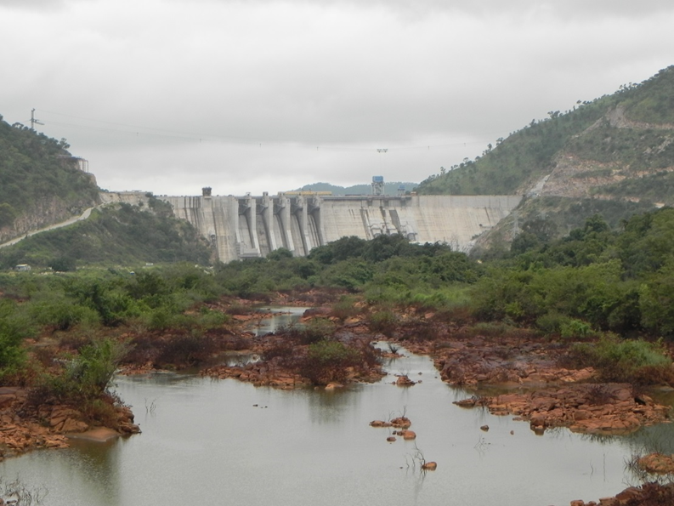
Content
1. China dams the world
2. Project overview
3. Case studies: Bui dam and Zamfara dam
4. Project outlook & conclusion
1.

Slide 3
1. China dams the world
Global renaissance of hydropower under Chinese leadership
China is the world’s largest hydropower dam builder in terms of number and size of dams built, investment sums and global coverage.
More than 330 Chinese overseas dams, about 40% in Southeast Asia and about 30% in Africa (International Rivers, 2014).
SOE Sinohydro plays major role
Long history of domestic dam-building, but recently many Chinese overseas dams in LMICs - ‘Going Out Strategy’ (Bosshard, 2009; McDonald et al, 2009; International Rivers, 2012)
Chinese domestic dam market is saturated, overseas opportunities for firms, jobs, tax, access to natural resources (McNally et al 2009).

Slide 4
Chinese builders involved in overseas dam projects
Chinese overseas dam projects by location – World regions
Data from International Rivers, 2014

Slide 5
2. Project aims & methodology
First comparative analysis of the environmental, social, economic and political impacts of Chinese hydropower dam projects in LMICs.
Conceptual framework: ‘Political ecology of the Asian drivers’
Combining the analysis of power relations over the access to natural resources (Greenberg & Park, 1994; Tan-Mullins, 2007) with assessing China’s impacts as a Rising Power and its channels of interaction with LMICs (Humphrey & Messner, 2005; Schmitz, 2006; Kaplinsky & Messner, 2008)
Themes: Organization and motives of Chinese hydropower actors; local and national impacts; governance implications; UK and OECD interests.

Slide 6
2. Fieldwork sites
Comparative case study analysis: 4 dams, 2 in Africa (Ghana, Nigeria), 2 in SE Asia (Cambodia, Malaysia) and fieldwork in China
Africa: Bui dam, Ghana and ‘Zamfara’ dam, Nigeria
143 interviews: 71 with institutional actors (policy-makers, firms, NGOs, experts), 72 with affected communities
40 focus group discussions
142 household surveys
Stakeholder mappings, data analysis, EIA analysis, literature reviews

Slide 7
3. Case study: Bui dam, Ghana
Located in Northern Ghana on the Black Volta River, within Bui National Park
400 MW, started operation in 2013
Built by Sinohydro
Funded by Chinese ExIm Bank, Government of Ghana, Government of China, $620 million, part of trade deal (International Rivers, 2014)
50% of Ghana’s population below poverty levels of 2$/day (World Bank, 2014)
30% of Ghanaians do not have access to electricity, 65% cook with traditional biofuels (World Bank, 2014)
Heavy reliance on hydropower for power generation

Slide 8
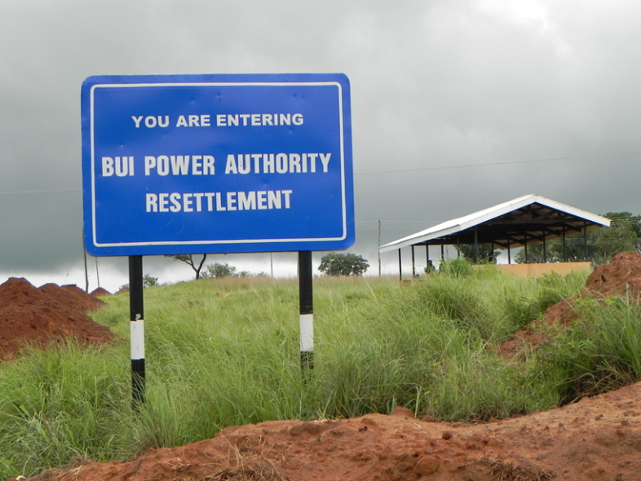
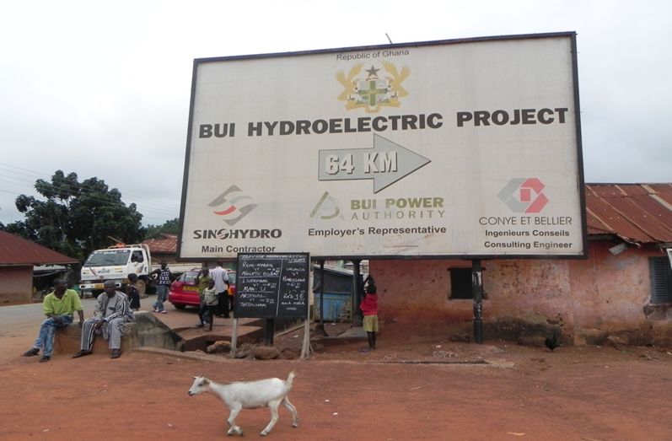

Slide 9
3. Social and environmental implications: Bui dam
Flooding of 6 villages, 20% of Bui National Park, loss of forest and savannah woodland habitat
Threats to endangered species, such as rare black hippo
Resettlement of 1,216 people, sometimes poor infrastructure in resettlement area
7,500 people have lost access to parts of farmland, grazing land and forests, loss of access to fishing grounds, negative impacts on livelihoods
Compensation payments and locals took part in consultation meetings, EIA process includes mitigation measures

Slide 10
3. Governance: Bui dam
Bui Power Authority manages dam, resettlements, compensations
Engineering, Procurement and Construction (EPC) / Turn-key Project Contract
Sinohydro is responsible for the construction of the dam and safety of workers, after construction the host government becomes responsible for the dam
ESIA conducted before the dam building started
Compliance with Ghana’s legislation
Still complaints from locals & lack of transparency from Bui Power Authority

Slide 11
3. Case study: Zamfara dam, Nigeria
Located in Northern Nigeria in Zamfara state, close to Gusau
In planning stage, not built
Projected generating capacity of 100MW
Projected cost about US$160 million, to be financed by ExIm Bank (International Rivers, 2014)
Proposed builders, developers and contractors are China Geo-Engineering Corporation CGC
80% of Nigeria’s population below poverty levels of 2$/day (World Bank, 2014)
50% of Nigerians do not have access to electricity, far more cook with traditional biofuels, in some areas up to 80% of the population (World Bank, 2014; IEA, 2014)
Insufficient power generation and lack of access to modern fuels, aggravated by challenges of corruption, unequal distribution of wealth & resources, instable security

Slide 12
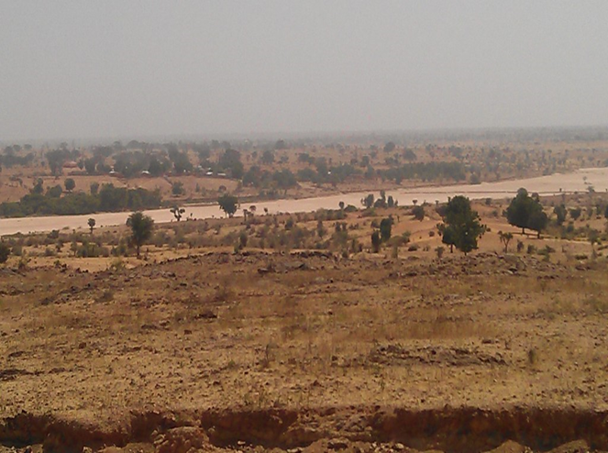

Slide 13
3. Lost case? The Zamfara dam, Nigeria
Dam not built, but surveys carried out
Local people from 8 villages were consulted, including for resettlement
Dam raises promises for a better life: employments, poverty reduction, infrastructure, water supply, electricity, improved security etc
Stark contrast to the disillusioned views of those who have been affected by Chinese-built dams in Africa and beyond
Dam deal negotiated by ex-governor, power shift means project is shelved
Difficult for smaller firm to negotiate deal with government in unstable political and highly corrupt system
Unstable security situation in Northern Nigeria due to Boko Haram
Overall unlikely that dam will be built in near future

Slide 14
4. Project outlook
UK / EU donor & firm interviews
Data analysis with Nvivo
Comparative analysis
Writing papers
Dissemination events

Slide 15
4. Conclusion
Dams are considered a low carbon energy source & are currently experiencing large growth, partly due to the climate change debate
China is at the forefront of this revival of dams, investing heavily on a global scale
China’s Sinohydro and China ExIm Bank play a large role in financing and building overseas dams, but also smaller players relevant, although with mixed success
The dam-builders’ behaviour towards the local environment, local communities and national legislations is shaped by the governance context set by the host country.
Ghana: set up a comprehensive governance framework and requested Chinese dam-builders to operate according to local legislations and best practice, still major impacts on local population
Nigeria: high hopes of local population for the dam, but slim chances dam will be built, lack of capacity at dam-builder and government level
Realising the low carbon transition? Yes, but the practices of both Chinese dam-builders and host countries need to be improved to increase the sustainability of dams and its local impacts.

Slide 16
Thank you for your attention
Questions?

