Slide 1
Mozambique’s multifaceted energy challenge
Joshua Kirshner
University of York
Maputo – March 19, 2015

Slide 2
Outline
1.) Mozambique’s “extractive turn”
Developing coal and offshore gas
Energy and infrastructural implications
2.) Energy access challenges
3.) Access through off-grid energy projects
Solar PV and micro-hydro as key technologies
Main actors and sources of finance
Key findings and future directions
Notes:
Brief outline

Slide 3
Mozambique’s extractive sector
Source: UNCTAD 2012
Notes:
MZ is in the midst of an extractive turn, and while there growing is interest in RETs, we must view it in this broader context
Table from UN Conference on Trade and Development, 2012 shows 10 largest ‘greenfield’ projects in extractive resources
-Mozambique figures in 3 of top 4
-Gives you a sense of actors involved, investment sizes – 2-3 billion USD, India’s Jindal in coal, also ENI (Italy) and Sasol (SA) in gas
-Note estimated jobs created is very low – 161 in ENI’s case

Slide 4
Notes:
MZ not a historically impt mining site or minerals producer (unlike South Africa or Zambia for ex.), did not appear on global mining co’s radar until the past decade.
This changed in 2008 – visiting geologists in the central prov. of Tete found the coal seam under Moatize basin contains high-grade coking coal, an ingredient in steel manufacture, also lower-grade thermal coal
But operations face infrastructure bottlenecks, hobbled by falling coal prices (since 2013)

Slide 5
Notes:
Acc to IEA’s Africa Energy Outlook 2014, MZ is now 2nd largest player in coal in Africa, following SA
(MZ has coking coal, which follows a different dynamic)
But companies operating in the country depend on a colonial-era, multi-use, single track railway – the Sena line (show on map)
MZ authorities rejected a proposal by RT of barging coal down the Zambezi River
So main transport option is railway–but capacity expansion and new infras are needed to foster export growth and sufficient economies of scale
Preferred route is the Nacala Corridor, a 900 km railway crossing via So. Malawi, linking to new deep water port at Nacala (show on map)

Slide 6
Key findings
Scramble to gain access to MZ’s energy resources
Beneficial ‘south-to-south’ partnerships balanced with push to higher carbon energy pathway
Coal-fired power plants (Vale, Jindal, ICVL)
Investments in logistics and regional transport infrastructure
Population displacement
Can these links be harnessed for long-term social and economic development? Energy access?

Slide 7
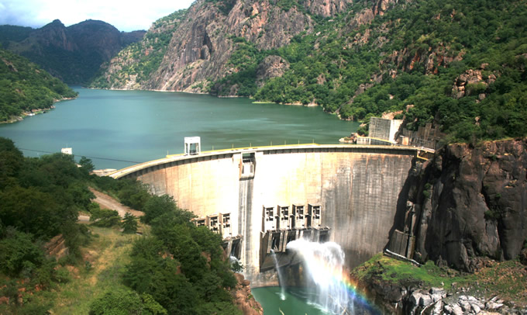
Energy access challenges
Notes:
MZ produces a huge surplus of hydroelectricity at Cahora Bassa Dam on the Zambezi (2075 MW)
But it still relies extensively on firewood and charcoal for the major source of energy for some 80% of the pop – higher in rural areas
Very little infrastructure has been installed to distribute power to local people, esp. outside major cities
Solar PV and RETs having growing presence in rural areas

Slide 8
Four decentralised, off-grid energy projects observed

Slide 9
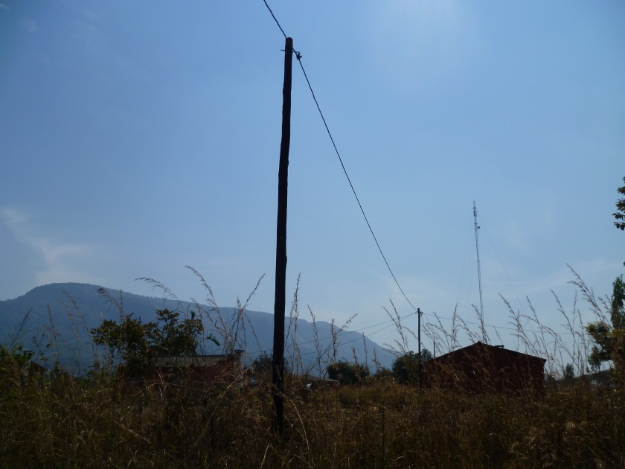
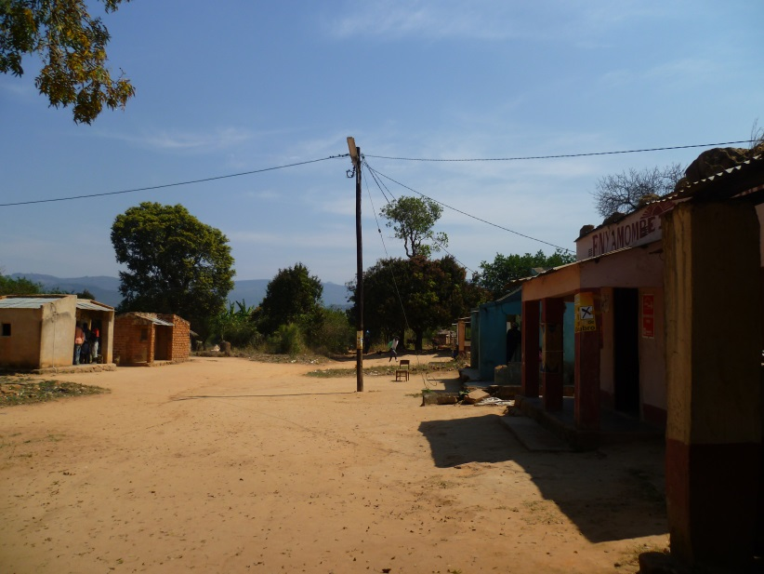
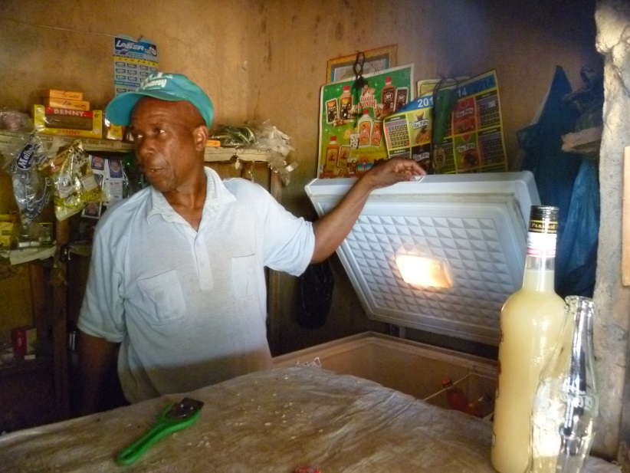
Chinhambuzi, Manica province
Notes:
FUNAE with financial support from Belgian Gov, BTC
Mini-grid system is linked to admin building, primary school, police and 6 teachers houses, and 10 bancas fixtas
But ordinary residents remain unconnected
Lacking payment system – shopkeepers pay MT 70 (about $2.50) - symbolic
Can see potential for spontaneous or illegal connections – local residents wish to be connected
Lack of capacity (only up to 5 kW) in system
Majority of HH rely on burning wood or charcoal for cooking and heating

Slide 10
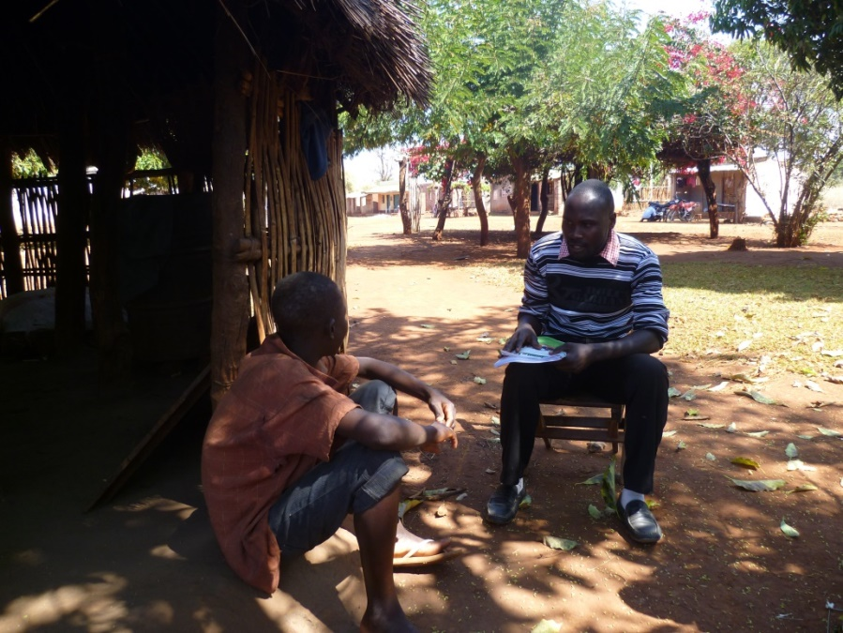
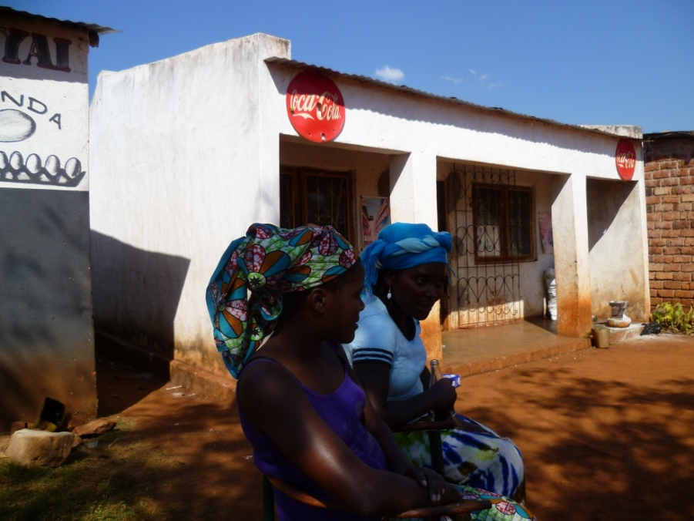
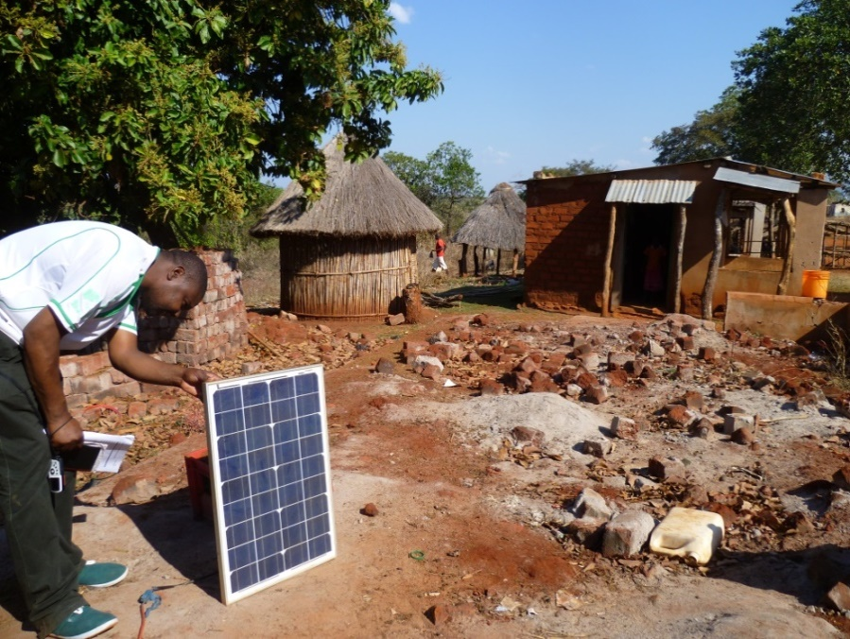
Mavonde, Manica province
Notes:
FUNAE project, finance through the World Bank’s ERAP programme
Solar stand-alone systems (SHS) in school, clinic, homes and bancas fixas (fixed stalls)
8 months later, contracts not being honoured by both parties
2 out of 10 street lights working – both close to administration building and staff houses
FUNAE’s project is having (unintended) effect of raising shopkeepers’ profitability – (they tend to be among the better-off in the village)
DIY solar panels are also important, indicating pre-existing demand for electricity
Chefe do posto is proud of SHS, even if they don’t work – many nearby villages lack them

Slide 11
Notes:
Solar PV street light

Slide 12
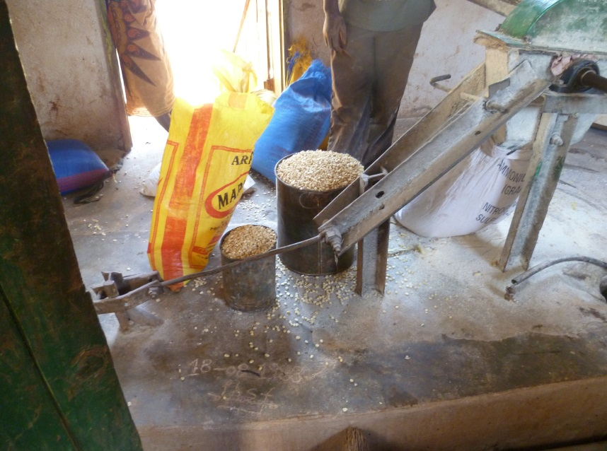
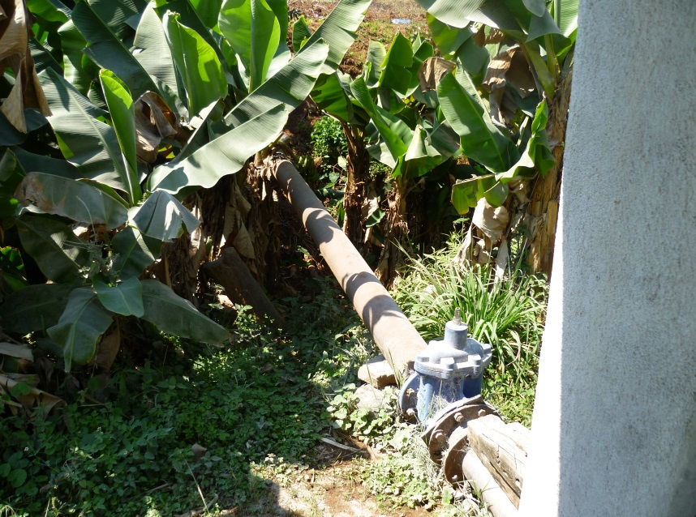
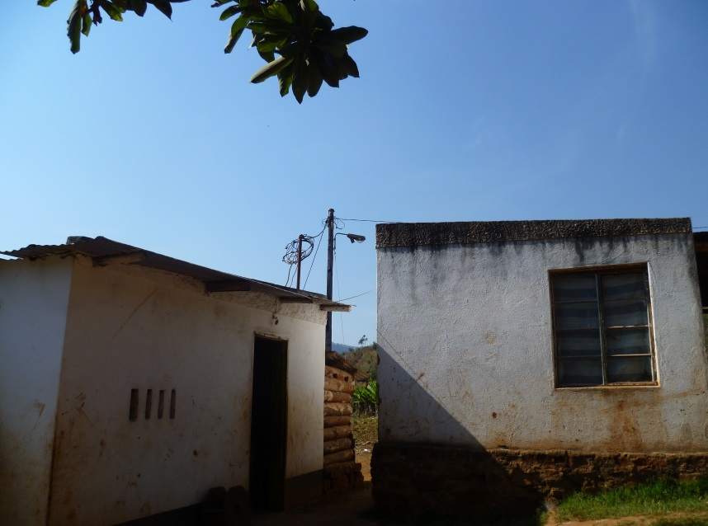
Chua, Manica province
Notes:
Micro-hydro project, one of several in the region supported by German Int’l Cooperation (GIZ), in collab with KSM
This project commissioned in 2008, 22 kW capacity
Power used for milling by day (upper right), electricity by night (mini-grid at lower left)
The grid connects - 29 HH and 23 small shops – pay monthly fees
GIZ provided a soft loan to owner, Mr. Lino Ncada, finished paying loan in 2013
Mr. Lino wants to build a second system nearby and hire local people to build and help run it, viewing it as a business opportunity
Turbines produced locally, generators imported from Germany (through South Africa via agents)

Slide 13
Notes:
Team of surveyors with Practical Action

Slide 14
Notes:
Themba of PA interviewing Mr Lino Ncada, own of the system owners

Slide 15
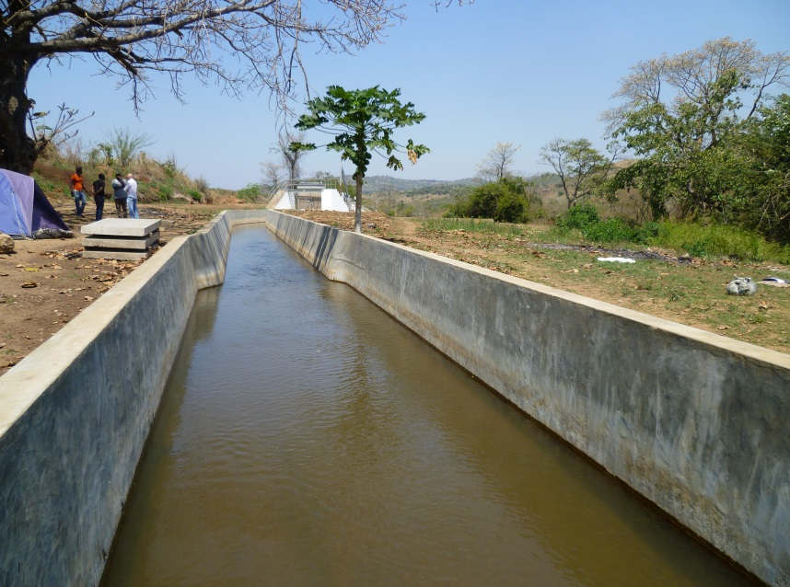
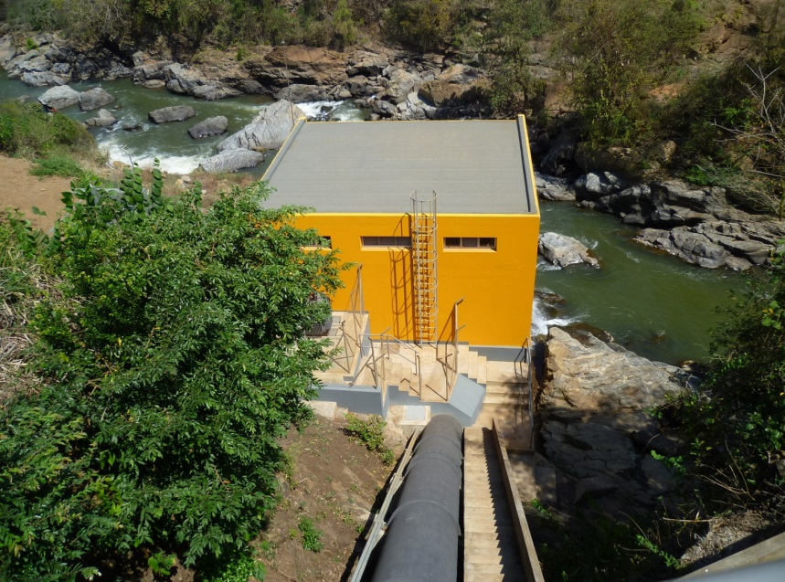
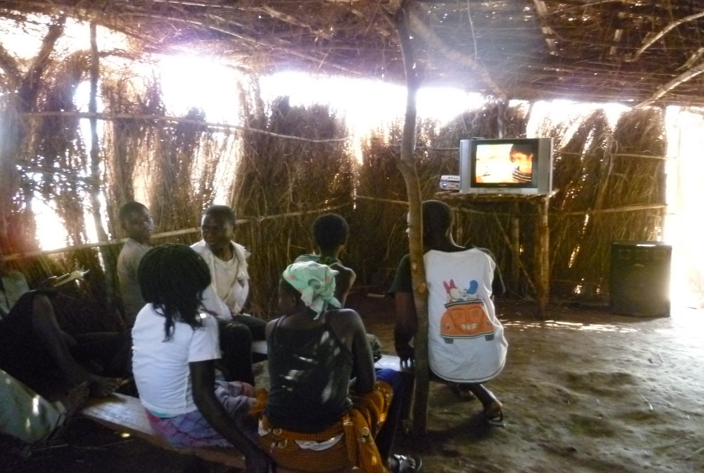
Majaua-Maia, Zambezia province
Notes:
Mini-hydro system, financing from EU, managed by FUNAE
Rehab of a hydro-powered mill owned by a Portuguese settler (Mr. Maia), abandoned site in 1980
700 kW capacity, mini-grid extends 4 km (plans to extend much further, out to 40 km)
3 video clubs (at lower right), but the 2 local grinding mills were unconnected
Women must cross a river into Malawi to grind corn
At a mill powered by diesel-generator
No payment or revenue collection system in place/ raises questions of willingness to pay
Limited sense of local ownership in project design – ‘fiscal’ (supervisor) from Beira, assistants from Nampula and Quelimane – perhaps a lost opp to train local people for these positions

Slide 20
Key findings
Energy access as more than a technical ‘fix’
What can energy be used for? Relevance for local communities
Local participation can offer greater responsiveness to community energy needs
Supply-based and demand-based approaches
Solar PV and RETs will be developed alongside extension of the nat’l grid

