Slide 1
The Rising Powers in Mozambique: high carbon partnerships?
Joshua Kirshner
Durham University
Notes:
You may wonder why I am speaking about ‘high carbon partnerships’ when our project focus is ‘low carbon transitions’
We’ve found the “elephant in the room” is high carbon; vastly overshadows investments in RET
MZ has recently gained att’n as an emerging energy frontier
It is on the cusp of a coal and gas boom,
but this presents a range of logistical and political challenges for the country, still one of the world’s poorest

Slide 2
Outline
Mozambique’s extractive turn
The rise of coal
Vale as “early mover”
Indian actors
Infrastructure challenges
Developing offshore gas
ENI and Anadarko as key players
Asian importers securing supplies
Key findings and implications
Notes:
Brief outline

Slide 3
Mozambique’s extractive sector
Source: UNCTAD 2012
Notes:
MZ is in the midst of an extractive turn, and while there is interest in renewables, we must view dev of low carbon in this broader context
Table (from UNCTAD, 2011) show the 10 largest greenfield projects in extractive natural resources
-Mozambique figures in 3 of the top 4
-Gives you a sense of actors involved, investment sizes – 2-3 billion USD, India’s Jindal in coal, also ENI (Italy) and Sasol (SA) in gas
-Note estimated jobs created is very low – 161 in ENI’s case

Slide 4
Notes:
MZ not a historically impt mining site, or minerals producer, didn’t appear on global mining co’s radar until past decade.
This changed in 2008 – visiting geologists in Tete found the coal seam under Moatize basin is world’s largest untapped deposit
Contains high-grade coking coal, an ingredient in steel manufacture
But operations face serious infrastructure bottlenecks, hobbled by falling coal prices (since 2013)
(Point to Tete on map, also note offshore gas deposits -- I’ll turn to next)

Slide 5
Notes:
Acc to IEA’s Africa Energy Outlook 2014, MZ is now 2nd largest player in coal in Africa, following SA
(MZ has coking coal, which follows a different dynamic)
But companies operating in the country depend on a colonial-era, multi-use, single track railway – the Sena line (show on map)
MZ authorities rejected a proposal by RT of barging coal down the Zambezi River
So main transport option is railway–but capacity expansion and new infras are needed to foster export growth and sufficient economies of scale
Preferred route is the Nacala Corridor, a 900 km railway crossing via So. Malawi, linking to new deep water port at Nacala (show on map)

Slide 6
Coal in Tete province
Vale (Brazil) is largest investor
Moatize coal project
300 MW coal fired power plant
Emphasis on logistics - Nacala Corridor
Shares to Mitsui (Japan)
Rio Tinto (UK)
Tata (India) has 35% stake in key operation
RT sold holdings to ICVL (India) in 2014
Jindal (India)
Notes:
Vale of Brazil is largest investor (in MZ’s coal industry)
In 2008, Vale opened the Moatize project to export coking coal to markets in India, China, Gulf States
It plans to build a 300 MW coal-fired power plant, using thermal coal, w/ excess power for the nat’l grid
Vale has spent $2million to set up its Moatize operation
But this figure is vastly exceeded by Vale’s investment of $4.4bn in Nacala Corridor project
A consortium called the Integrated Nacala Logistics Corridor (CLN) will run the port and coal terminal – Vale has 80% share
Signalling shifts in the sector, Mitsui (Japan, commodities trading firm) agreed to invest almost $1bn in Vale’s coal projects in MZ, Dec 2014
Mitsui will also acquire 50% stake in Vale subsidiary, which has been promoting the Nacala Corridor (acc to FT)
Suggests that these investments are focused as much, if not more, on logistics and regional infras networks as on coal

Slide 7
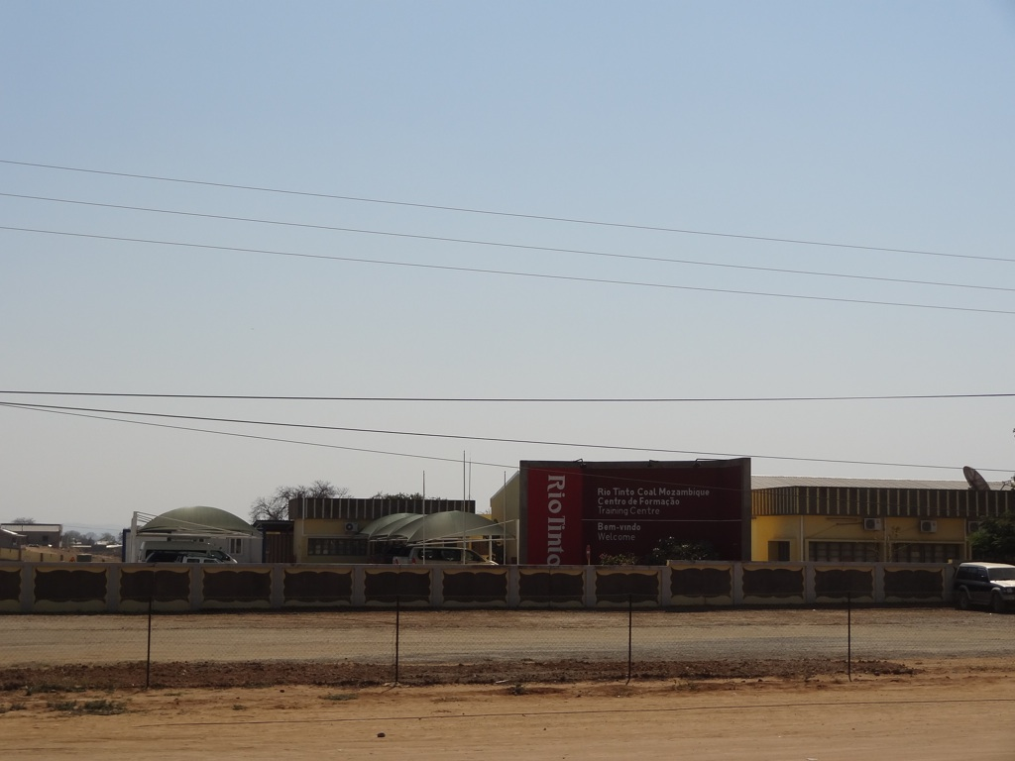
Notes:
Second major investor is Rio Tinto (the UK-based mining group)
Tata Steel (India) owns 35% stake in its largest concession, the Benga mine
RT unexpectedly ‘wrote down’ its assets in MZ in 2013;
in July 2014, RT sold its holdings to Indian state-run ICVL for $50 mn, 3 years after paying $3.7 bn for the mines
ICVL’s first shipment of coal from Beira port arrived in India in Nov 2014

Slide 8
Notes:
Jindal holds a separate concession, and is planning a 300 MW coal-fired power plant on-site, similar to Vale’s proposed plant
Falling oil prices have spurred further declines in coal prices
But (as J. Hanlon has observed) Indian demand may keep the coal mines in Tete afloat
India has substantial coal reserves, but poor quality, high ash content
India one of world’s largest emitters of carbon
NYT reported that in last 5 years, India increased its coal-fired generation capacity by 73%, coal mining only grew by 6%, leading to expensive coal imports and idle plants
More broady, Africa as an energy supplier has gained growing signif. in India’s foreign and energy policy
India incr. competes with China in creating linkages with Africa’s energy sector -- has taken a “back seat” -- but this is changing
India aims for distinctiveness, pursuing a model combining extraction w/ long-term industrial dev, capacity bldg. and training in host country or region
(will be interesting to see if ICVL will continue to run RT’s Training Ctr, or if it pursues a ‘race to the bottom’)
(Photo of the Chirodzi concession near Cahora Bassa dam)
More broadly, the decisions of China and India will influence those made by smaller dev countries

Slide 9
Notes:
Carrying coal on the Sena line from Vale’s Moatize mine – photo from Sofala province

Slide 10
Notes:
Moatize railway station – some passenger service on the Sena railway

Slide 11
Notes:
View of the unplanned outskirts of Tete city, airport in background – these communities and the airport are slated to be moved to make way for additional mines –
Now operated by ICVL

Slide 12
Developing Offshore Gas
Anadarko (USA) and ENI (Italy) made vast offshore gas finds in 2011
Analysts project MZ will receive US$115 bn in revenue from LNG exports between 2020-2040
Requires developing 2 LNG facilities
Cost estimates for first phase of upstream and LNG development in MZ ($16 bn) above the country’s annual GDP ($15.3 bn in 2013)
Notes:
Major offshore gas discoveries in MZ have created high expectations about opps for domestic economy and supply to global markets
In 2011, ENI and Anadarko made vast offshore gas finds in the Rovuma Basin, on the Tanzania border, some 30 miles offshore
Analysts project MZ will receive $115 bn in revenue from LNG exports between 2020-2040
Requires developing 2 greenfield LNG facilities – being led by ENI and Anardarko, firms that operate the two large gas fields
Capital intensive, cost estimates higher than MZ’s GDP in 2013
But favourably located, rel. close to Asian markets
Main mkt is Asian countries – seek steady supply, willing to risk price variations
Several large Asian importers are buying up blocks – CNPC, ONGC, PTT, Mitsui, Kogas
Also interest from Europe- alternative to gas piped in from Russia
India signed MoU with MZ to import more gas

Slide 13
Key findings
Scramble to gain access to MZ’s energy resources
Beneficial south-to-south development partnerships balanced against push toward higher carbon energy pathway for MZ
Investments in logistics and reg. transport infras
Population displacement
Can these links be harnessed for long-terms social and economic development?

