Slide 1
Energy transitions and low carbon development in Mozambique
Marcus Power (Durham University)
Maputo, March 19th 2015

Slide 2
About the project
‘The Rising Powers, Clean Development and Low Carbon Transitions in Southern Africa’: a 30 month project ending May 31st 2015, funded by the UK’s Economic & Social Research Council (ESRC)
how, why & to what extent China, India & Brazil are enabling the transition to low carbon energy systems in Southern Africa (case studies of Mozambique & RSA)?
assessing the consequent implications for the affordability, accessibility & sustainability of energy services in the region
focus on three key processes: (1) investment (2) innovation (3) infrastructure development

Slide 3
Project partners
http://www.dogweb.dur.ac.uk/the-rising-powers/

Slide 4
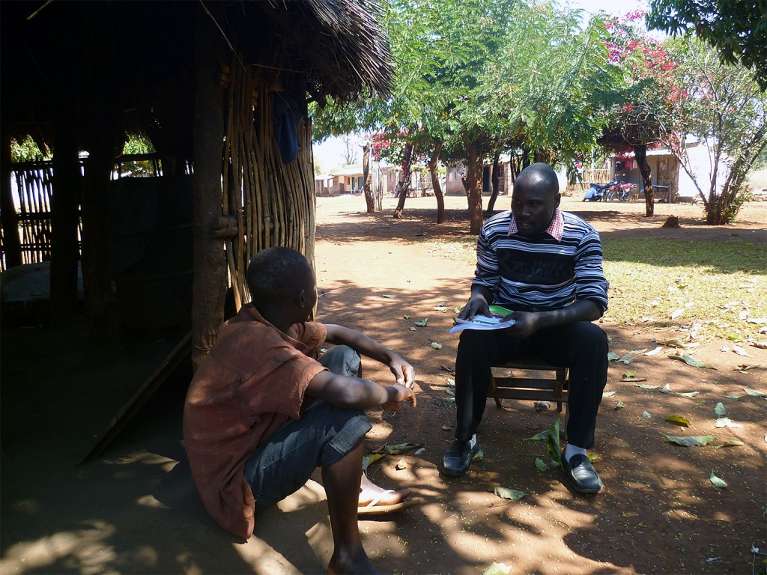
Project methodology
creation of a database of 150 low carbon energy projects in Mozambique/South Africa
200 interviews undertaken in Mozambique, South Africa, China, India & Brazil (2012-14)
Community-based participatory research in Maputo, Manica & Zambézia provinces
how energy services & technologies are used/organised at the local level, how these technologies are affecting energy access, affordability & sustainability

Slide 5
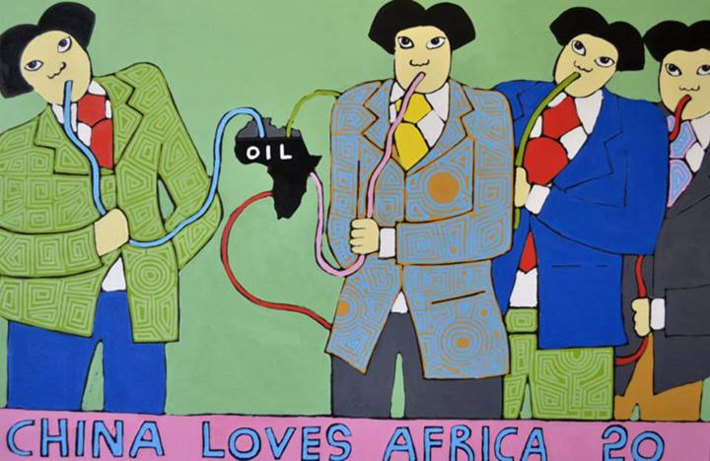
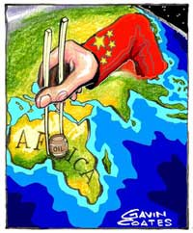
The ‘rising powers’ & ‘South-South’ co-operation
(Re)emergence of BRICs as ‘shapers’ of international ‘development’
The ‘rise of the South’, the growing significance of ‘south-south’ development co-operation
Plunder & Grabs: Primarily seen in terms of exploitative acquisition of natural resources (coal, oil & gas)
This story overlooks simultaneous & growing involvement in clean energy technologies & in reconfiguring energy systems across Africa
Notes:
neo-colonial plunder/grabs
Beyond extractivism-
Capture complexity of engagement with energy systems

Slide 6
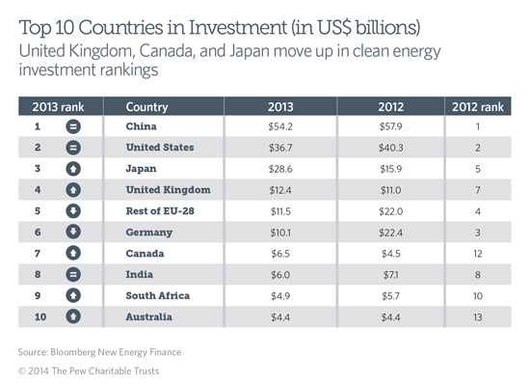
The ‘rising powers’ & energy transitions
Brazil: global leader in the biofuels industry
China: large hydro projects; world’s largest producer of wind turbines, PV, solar water heaters & small hydro, CCS technologies
India: wind & solar
South Africa: powerful investor within the Southern African region

Slide 7
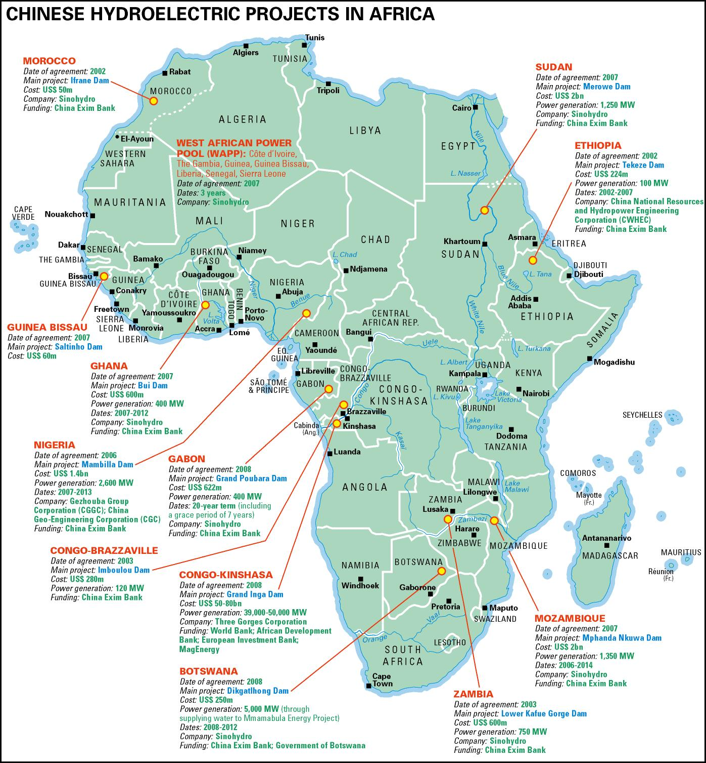
The ‘Rising Powers’ & clean energy
China, India & Brazil increasingly including renewable energy projects as part of their ‘aid’, loan & investment portfolios in Africa
The lure of government subsidies & feed-in tariffs in Africa, the domestic imperative to ‘go out’ in search of foreign markets, renewable energy capacity in return for access to oil, coal, gas etc.
Steady increase in 3 specific capacities:
as exporters of renewable energy equipment (e.g. wind turbines, solar panels, biofuels production technologies)
as investors in local equipment manufacturing (e.g. ethanol or solar water heater manufacturing plants)
as financiers & builders of renewable energy generation (e.g. wind farms, HEP plants)
Notes:
Proyectos hidroelectricos chinos
Interests right across the region- this is just hydro

Slide 8
Enabling low carbon development
“Low carbon development is a model of development that is based on climate-friendly low carbon energy and that follows principles of sustainable development, makes a contribution to avoiding dangerous climate change and adopts patterns of low carbon consumption and production”
(Urban and Nordensvärd, 2013: 5).
encompasses a complexity of stakeholders from the public, private, national/international & political & economic spheres

Slide 9
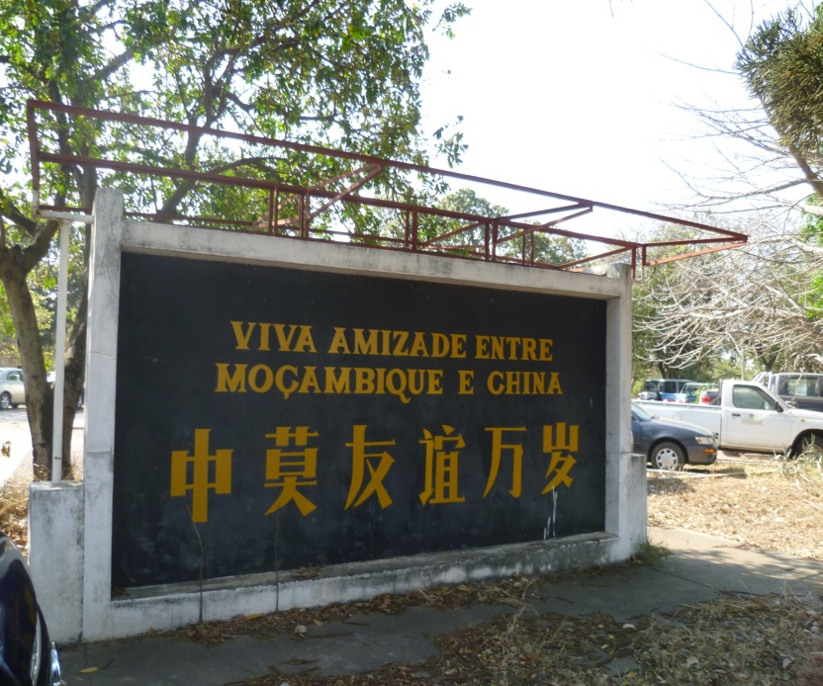
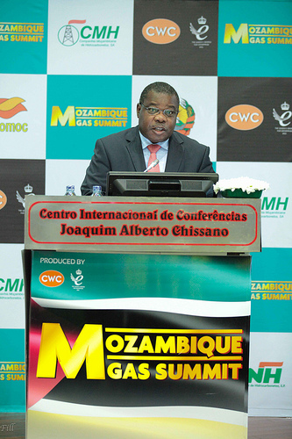
Sustaining a high carbon regime in Mozambique?
Mozambique as the ‘world’s hottest new hydrocarbons frontier’, as one of Africa’s leading ‘emerging markets’
Mozambique courted by a range of international partners in recent years
Declining dependence on foreign aid (57% in 2009 to 33.5% in 2014)
The wealth generated by the extractives boom as a unique opportunity for addressing sustainable energy access?
Notes:
foreign aid in 2009 accounted for some 58% of total government expenditure
as a direct result of the extractives boom, the level of aid dependency has been significantly reduced as foreign aid covered 33.5% of the State Budget in 2014

Slide 10
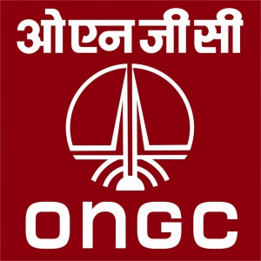
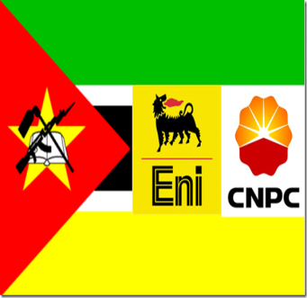
Sustaining a high carbon regime in Mozambique?
Availability of coal resources in Tete attracting mining companies: Vale (Brazil); Tata Steel; Jindal Steel & Power (JSPL); Coal India Ltd
Indian firms (ONGC Videsh) & Chinese firms (China National Petroleum Corporation) have bought stakes in offshore gas
Vale (Brazil) and Jindal (India) have invested in 300MW coal-fired power plants in Tete province
State Grid Corporation of China involved in the construction of new transmission facilities (CESUL), share in Cahora Bassa (through REN)
Notes:
Key stakeholders include Vale (Brazil) - has invested US$2 billion and plans for a further US$4 billion in next 5 years
Indian firms a growing presence - Tata Steel, Jindal Steel & Power (JSPL), Bharat Petroleum, Videocon Industries, Coal India Ltd
Vale and JPSL have plans to construct coal-fired power stations
Indian firms (ONGC Videsh, OVL & its partner Oil India, OIL) and Chinese firms (China National Petroleum Corporation) have bought stakes in offshore gas
Portuguese power grid company Redes Energéticas Nacionais (REN) bought a 7.5 percent stake in the Cahora Bassa (HCB) facility in April 2012, shortly after the State Grid Corporation of China (SGCC) had purchased a 25 percent stake in REN

Slide 11
Sustaining a high carbon regime in Mozambique?
The Estratégia Nacional de Desenvolvimento (ENDE) sees the resource boom as a ‘starting point’ from which to effect a shift in emphasis from poverty reduction to industrialisation
The plan sees a number of ‘transformative’ industries, including mining, the extractive industries & power generation in the ‘vanguard’ of Mozambican modernization
How equitable and sustainable will this development be? How closely oriented toward the needs of Mozambicans?
The ‘extractivist mindset’ (Klein, 2014) of treating land & people as resources to deplete and exploit, the enclavic nature of extractive industries

Slide 12
Investments in mining: ‘leaving no one behind’
“We have to be smarter [and] more targeted than we have been before…. We are the owners of these [natural] resources…We must know how the mining industry is part of the package that will improve the lives of millions of our people…Otherwise we get left with big holes and no skills and no value chains”
(Graça Machel, speech to Alternative Mining Indaba, February 11th 2015)
Notes:
the call for communities to be involved in negotiations with multinational companies for benefits arising out of investments on their land
communities & civil society had to know how the mining contracts were established, question whether they were understandable
communities have to know the costs of resettlements they were being asked or forced to make and that what they received as compensation corresponded with the impact to be felt by the community for generations to come
the need for building of ‘civic consortiums’ with many disciplines to engage multinational companies on all aspects of contracts entered into

Slide 13
Whose energy needs?
“It is not a question of whether Mozambique has the capacity to produce energy, because we produce so much that it is likely that we can be nationally self-sufficient if we use all the coal and hydro power domestically. It is a question of the fundamental orientation in generating power: to generate profit for transnational companies or to generate fuel for the Mozambican people’s needs?”
Diamantino Nhampossa,
União Nacional de Camponeses (UNAC)
(cited in Borras et al (2011)
Notes:
Raises these key questions

Slide 14
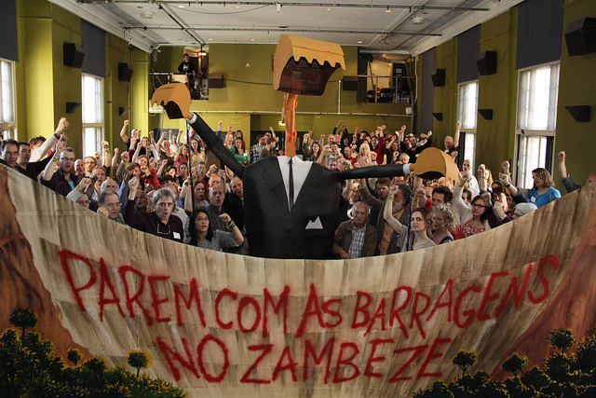
Sustaining a high carbon regime in Mozambique?
Mozambique’s energy sector secured 45.6% of all investments approved by the CPI in 2014, attracting over US$3.238 billion for just five projects including:
Lupata & Boroma HEP in Tete, (Mauritius); ACWA Power Moatize thermoelectric plant in Tete (UAE), Buzi Thermal Power Plant in Sofala (Portugal)
Civil society concerns about the socio-ecological implications of energy-related mega-projects (e.g. Mphanda-Nkuwa)
A ‘post-colonial amnesia’ (Isaacman, 2013)?

Slide 15
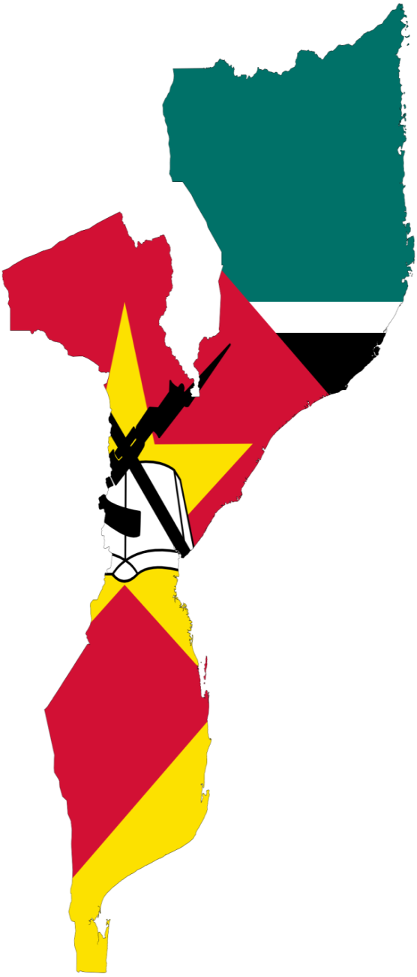
Mozambique’s energy system
limited grid infrastructure focused on urban spaces & oriented toward export to regional markets
rapidly growing domestic demand for energy
steady expansion of energy grid, but mainly to district centres & major towns
limited infrastructure for distributing power
centralized approach to electricity supply
low (but rising) levels of access to electricity
around 75% of population is off-grid
approx. 80% of population using biomass
dependence on large-scale hydro-power, only a few small & micro-hydro projects have been completed in recent years
Initial enthusiasm about biofuels but many projects have stalled

Slide 16
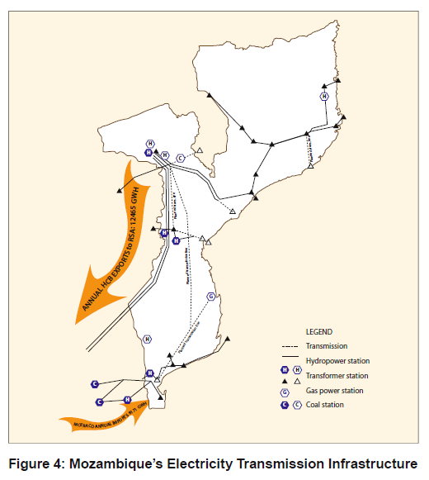
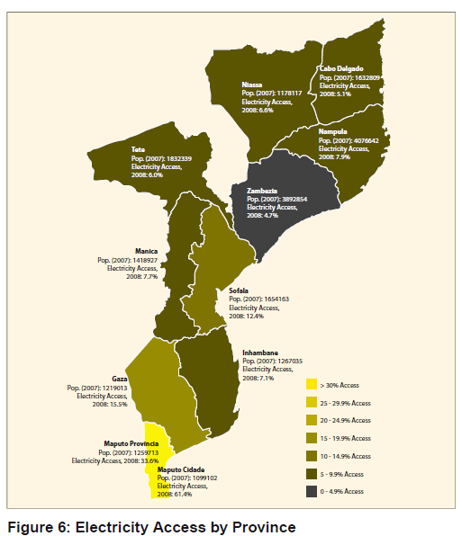

Slide 17
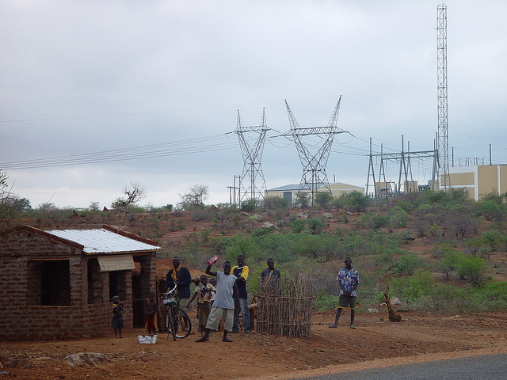

Slide 18
Key database findings
92% of RE projects in Mozambique are rural in nature, variety of technologies used but solar PV is dominant (39%), most are off-grid (47%), almost half are projects are 1MW in scale
amongst the ‘rising powers’ India leads as project developer with 15% of projects, solar PV manufacturing plant in Beluluane
Brazil with 3%, no ‘formal’ presence as yet for China in clean energy sector (beyond import of Chinese solar systems & components)
Other emerging economies (e.g. South Korea)
European donors remain significant actors in funding local/small-scale renewables (scope for trilateral co-operation?)
Notes:
World Bank and African Development Bank also providing important finance for rural electrification and grid extension

Slide 19
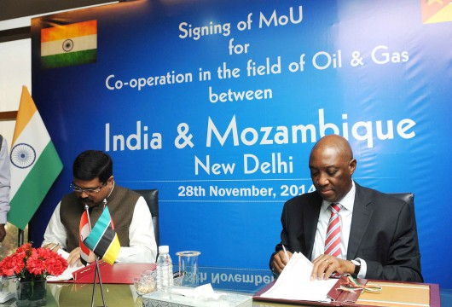
Conclusions
Increased RP interest in investing in renewable technologies & infrastructures
‘Rising Powers’ actors are not the determining or dominant actor in any low carbon development sector
investments are not explicitly driven by state-led ‘South-South cooperation’ agendas or bilateral cooperation, variety of state/non-state & quasi-state actors involved
‘Rising Powers’ pursuing a myriad of different energy developments, multi-national resource conglomerates playing a key role in coal & gas extraction, embedding high carbon pathways?
Notes:
Scope for engaging futher with the ‘rising powers’ through the Energy Sector Working Group? Exchanging experiences of rural electrification.

Slide 20
Conclusions
Embryonic attempts in Mozambique to diversify the energy mix, multiple & overlapping energy pathways unfolding
Institutional strengthening & capacity development of the main public sector institutions (e.g. MoE, EdM, FUNAE) in order to improve their respective performance, governance & effectiveness
Developing the capacity of the private sector (e.g. local enterprises and NGOs working with renewable energy technologies), promoting market development
Improving maintenance of RE technologies, the challenge of monitoring RE projects after implementation
Focusing on facilitating & developing community-driven partnerships (rather than attracting foreign investors)
Notes:
Fedesmo or the Renewable Energy Association could be well placed to help with facilitating and developing community driven partnerships

Slide 21
Conclusions
Renewable energy ‘progress’ has been inconsistent and socially & spatially variable
The limits to grid extension (a technical but also a highly political process), reducing losses/outages & improving energy efficiency
the need for small-scale, democratic & community-managed renewable energy systems
the complex politics of ownership & community control over RE projects, the need for communities to have ‘energy sovereignty’ - Energy for whom and for what?

