Slide 1

www.steps-centre.org/project/low_carbon_development
Pro-poor pathways to low carbon development
Lessons from off-grid solar electrical services in Kenya
Dr David Ockwell
Feb 2015
D.G.Ockwell@sussex.ac.uk

Slide 2
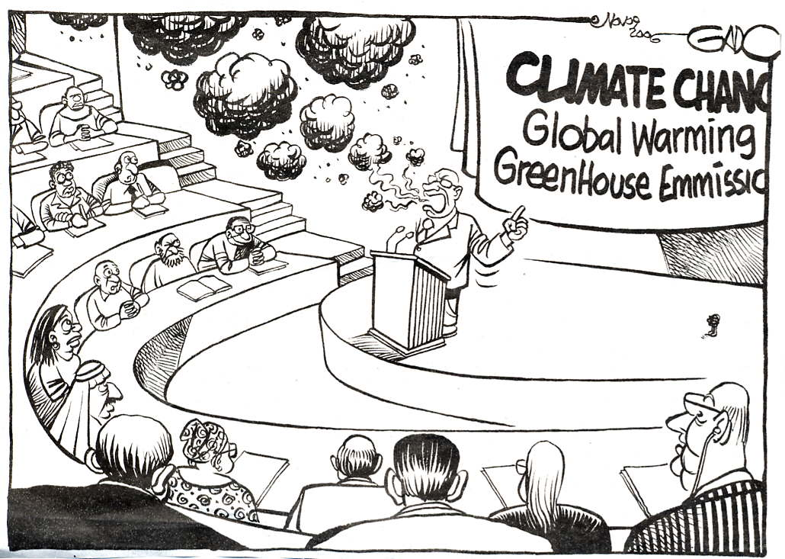
Notes:
Delighted to be speaking at a meeting of the TEC on Innovation Systems
For too long climate policy dominated by funding for individual hardware investments (leading to the kind of frustration captured in this cartoon)
New interest in Innovation System Building under Convention = most constructive way forward yet to deliver against commitments on tech tfr and dev
Empirical evidence for efficacy of Innovation System Building reflects decades of research (in Innovation Studies and more recently in Socio-Technical Transitions), explaining the rise of, for example, the Asian Tiger Economies; leading examples of climate technology innovation e.g. Korean Steel Industry & Kenyan Solar PV market; and explaining the barriers faced by many low income countries
Today I will focus on key policy goals for national and international policy to nurture Innovation Systems for climate tech transfer and dev
Outline how existing international policy architecture could be augmented to support establishment of Innovation System Builders by developing country Parties

Slide 3
Overview
Conceptual framework:
    Pathways to low carbon development (Stirling 2012)
    Alternative framings
Case study:
    Off-grid solar PV in Kenya

Slide 4
Case study
Off grid solar PV in Kenya
Per capita = most successful global market for off-grid PV
Source: Ondraczek, J. (2013) “The sun rises in the east (of Africa): A comparison of the development and status of solar energy markets in Kenya and Tanzania”, Energy Policy 56: 409

Slide 5
Research questions
What factors can explain the success of the off-grid PV market in Kenya?
Is this simply a free market success story?
What role has hardware financing played?
How can this inform policy?

Slide 6
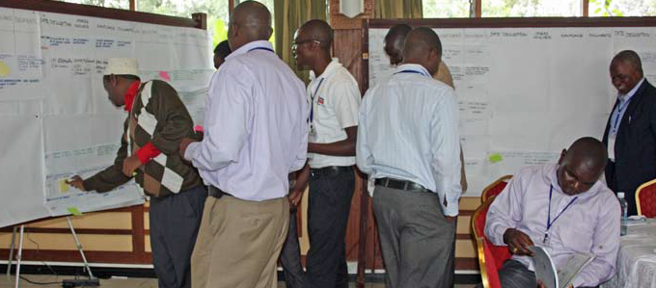
Methodology
In-depth historical analysis
Innovation Histories Method (Douthwaite & Ashby 2005)
Stakeholder workshop & interviews
Detailed timeline of PV market development
Interrogation against research questions

Slide 7

Multiple Pathways to “Low Carbon Development”
- What? For who? How?
Notes:
7
Slide source: Adapted from slide created by Prof Andy Stirling, LCEDN conference presentation, University of Sussex, Sept 2012 – see http://www.slideshare.net/Stepscentre/andy-stirling

Slide 8
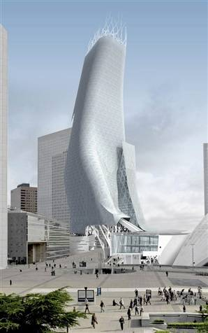
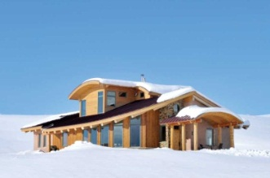
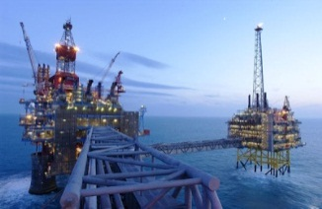


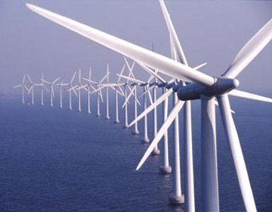
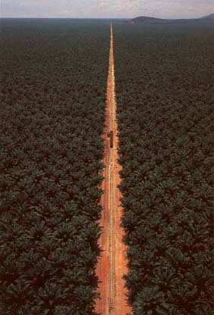
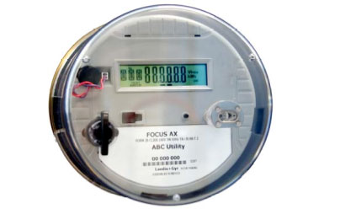
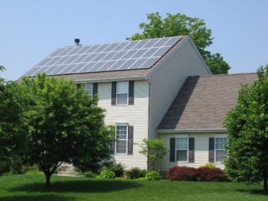
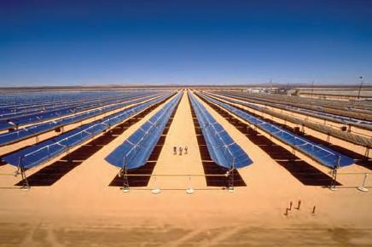
Multiple Pathways to “Low Carbon Development”
- What? For who? How?
- Multiple configurations of energy services, access, behaviour, technologies….
Notes:
8
Slide source: Adapted from slide created by Prof Andy Stirling, LCEDN conference presentation, University of Sussex, Sept 2012 – see http://www.slideshare.net/Stepscentre/andy-stirling

Slide 9
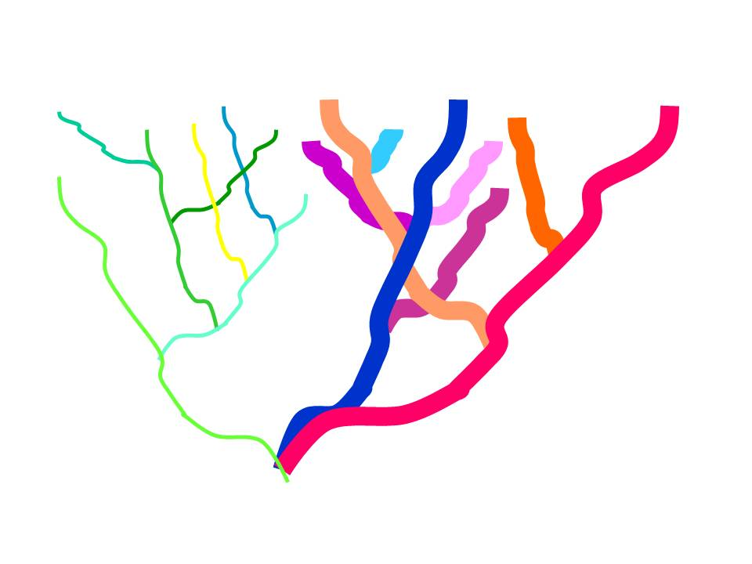


Intended and unintended processes and power ‘close down’ pathways
Social expectations, cultural norms
Notes:
9
Slide source: Adapted from slide created by Prof Andy Stirling, LCEDN conference presentation, University of Sussex, Sept 2012 – see http://www.slideshare.net/Stepscentre/andy-stirling

Slide 10
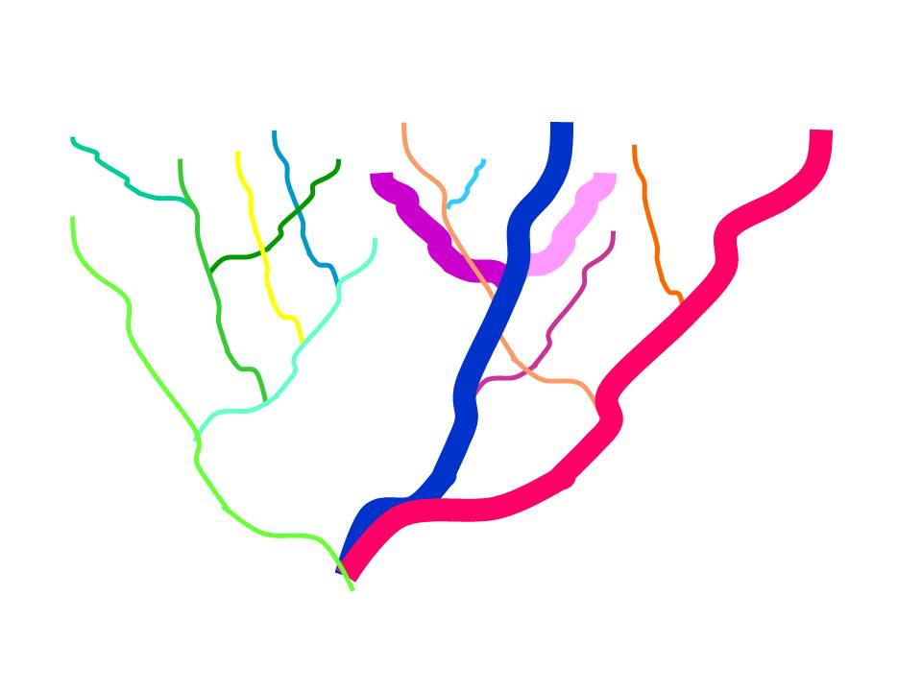
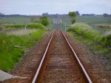

Intended and unintended processes and power ‘close down’ pathways
Historical contingency: Path dependence
Notes:
10
Slide source: Adapted from slide created by Prof Andy Stirling, LCEDN conference presentation, University of Sussex, Sept 2012 – see http://www.slideshare.net/Stepscentre/andy-stirling

Slide 11
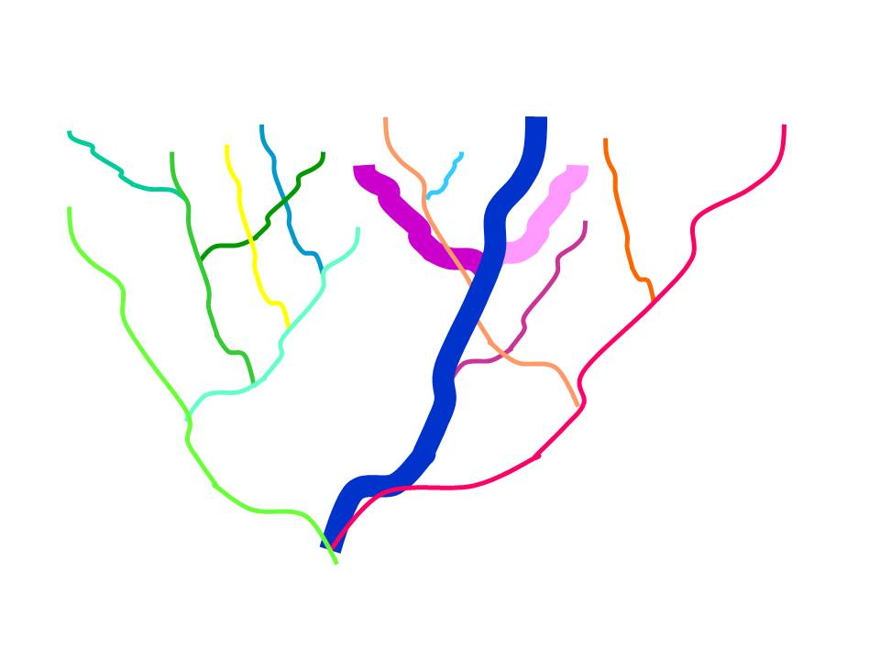

Intended and unintended processes and power ‘close down’ pathways
Politics: Interests, power – who frames the problem?
Notes:
11
Slide source: Adapted from slide created by Prof Andy Stirling, LCEDN conference presentation, University of Sussex, Sept 2012 – see http://www.slideshare.net/Stepscentre/andy-stirling

Slide 12
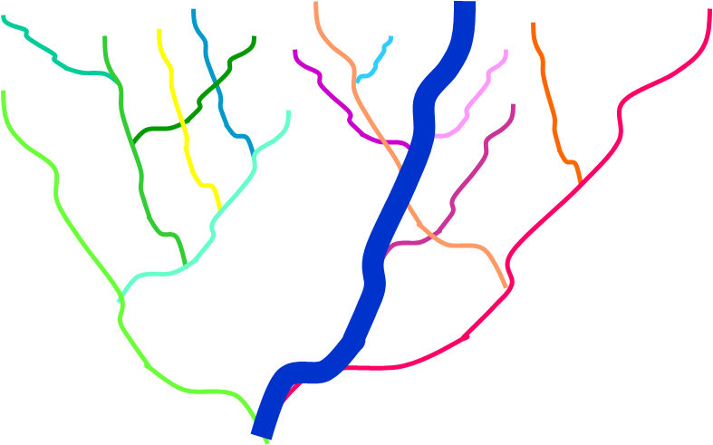

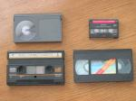
Intended and unintended processes and power ‘close down’ pathways
Economics: Lock-in to inferior technologies – even in competitive markets
Notes:
12
Slide source: Adapted from slide created by Prof Andy Stirling, LCEDN conference presentation, University of Sussex, Sept 2012 – see http://www.slideshare.net/Stepscentre/andy-stirling

Slide 13
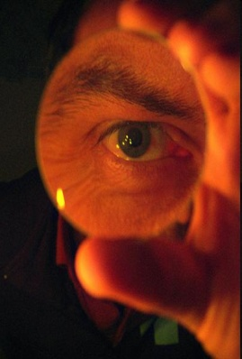
Dominant framing: Hardware financing
Hardware financing policies e.g. CDM
Internalise positive externalities (carbon mitigation) to cover additional cost of low carbon technologies

Slide 14
Accumulated investment through the CDM in countries and regions as at end of January 2014 (http://www.cdmpipeline.org)
Key
ROW: Rest of the World
 | CDM USD pc (2014) | CO2 tpc (2010) | USD pt CO2
China | 154 | 6.15 | 25
Mexico | 104 | 3.86 | 27
Brazil | 100 | 2.13 | 47
India | 31 | 1.62 | 19
Africa | 10 | 1.09 | 9
Sources: Authors, based on analysis of the CDM pipeline; World Development Indicators; http://www.nationsonline.org/oneworld/world_population.htm

Slide 15
CDM project investment per tonne CO2 emissions
Source: Authors, based on analysis of the CDM pipeline

Slide 16
Number of registered CDM projects as at end of January 2014, by project type (7412 total registered projects) (http://www.cdmpipeline.org)
90% registered CDM projects use seven types of technology
Only two new renewable energy technologies (although wind is mature relative to other new renewables)
Solar about 5% of portfolio
Source: Authors, based on analysis of the CDM pipeline

Slide 17


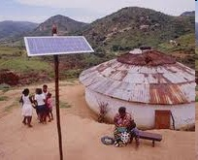



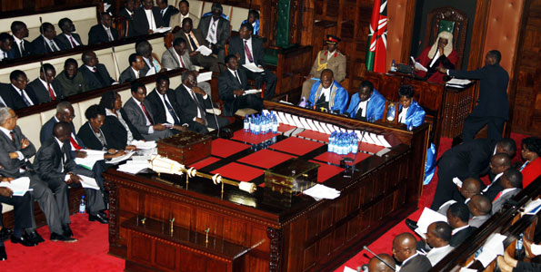
Alternative framing:
Building indigenous technological capacities within innovation systems
Technology transfer
National Innovation System
New production capacity
Capital goods, services & designs
Skills & know-how for operation & maintenance
Enabling environment
Knowledge & expertise behind technology
Accumulation of innovation capacity

Slide 18
Accumulated investment through the CDM in countries and regions as at end of January 2014 (http://www.cdmpipeline.org)
Key
ROW: Rest of the World
 | CDM USD pc (2014) | CO2 tpc (2010) | Ratio: USD / tCO2
China | 154 | 6.15 | 25
Mexico | 104 | 3.86 | 27
Brazil | 100 | 2.13 | 47
India | 31 | 1.62 | 19
Africa | 10 | 1.09 | 9
Sources: Authors, based on analysis of the CDM pipeline; World Development Indicators; http://www.nationsonline.org/oneworld/world_population.htm

Slide 19
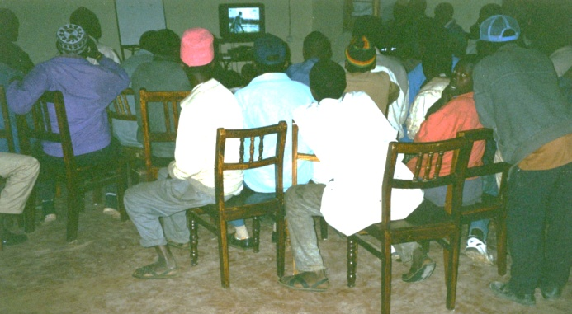
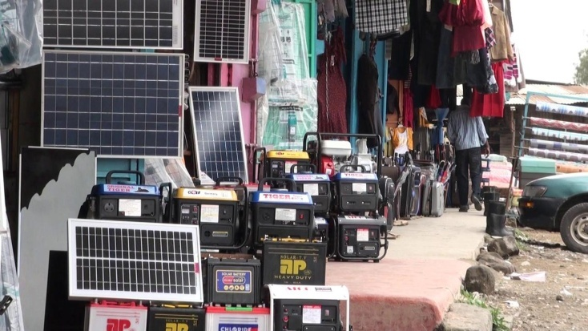
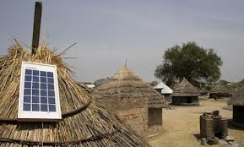
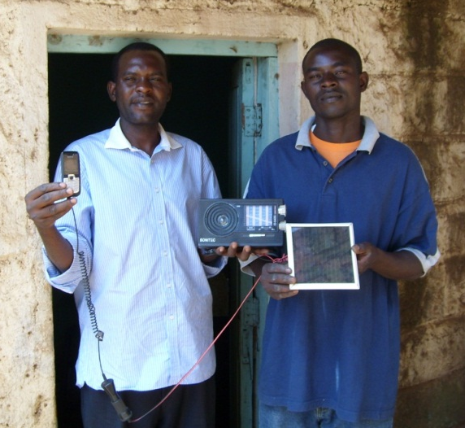

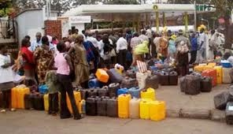
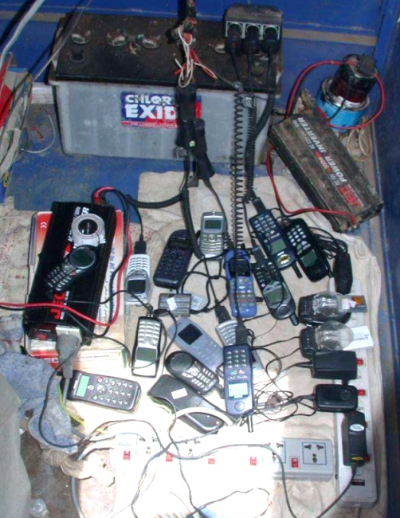

Socio-technical nature of change & development
Notes:
The same emphasis on Innovation System Builders is seen in more contemporary (and very powerful) work on socio-technical transitions
Here, technologies are understood as artifacts of co-evolving relationships between social practices and technological hardware – relationships which fundamentally define the nature and direction of innovation and the nature of technological change and development (e.g. climate compatible or not)
Furthermore, it allows us to understand pockets of climate technology activity as niches which need to be strategically connected up to the point where climate technologies begin to compete within regimes dominated by powerful, socially and politically embedded regimes of high carbon, non-climate resilient practices

Slide 20
Socio-technical nature of change & development
Notes:
But once again, in the socio-technical transitions literature, a systemic approach is emphasises and a key role afforded to actors – Innovation System Builders – who connect up niches, establishing innovation systems and building national technological capabilties

Slide 21
Conclusion: Pro-poor pathways to low carbon development?
www.steps-centre.org/project/low_carbon_development
Notes:
21
Slide source: Adapted from slide created by Prof Andy Stirling, LCEDN conference presentation, University of Sussex, Sept 2012 – see http://www.slideshare.net/Stepscentre/andy-stirling

