Slide 1

The role of the Renewable Energy Association in Mozambique
Energy and Development in Mozambique: Opportunities and Challenges
Hotel VIP Grande, Maputo, Mozambique, March 19th 2015
Hosted by Durham University and Eduardo Mondlane University

Slide 2
Background
AER Mozambique:
Created in April 2013;
Launch Workshop, in assocation with GIZ, in Nov 2013;
Current 30 members (17 local and international companies, and 13 individuals);
MoU with TAREA (Tanzania Renewable Energy Association) and APER (Portuguese Renewable Energy Association);
Participation various conferences including the Africa Renewable Energy Alliance (AREA)

Slide 3
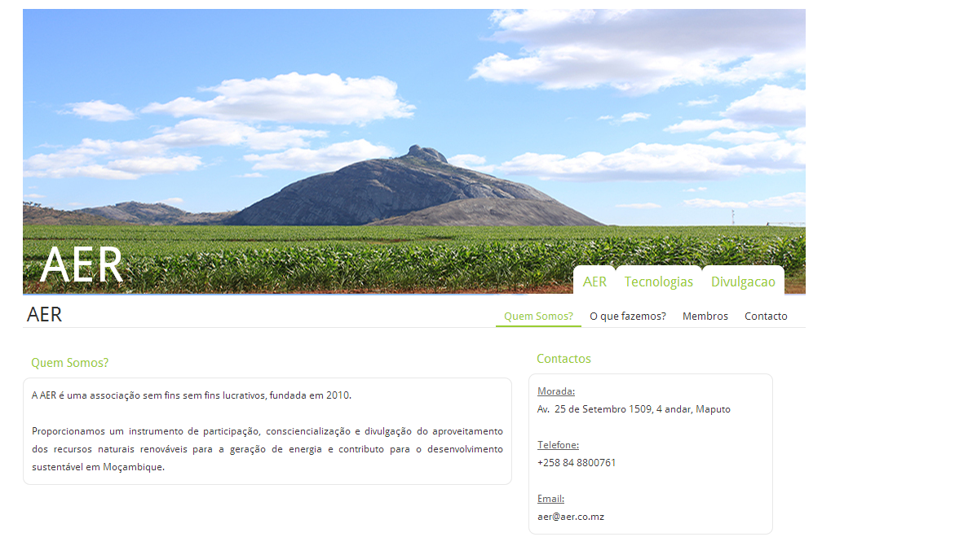
Website

Slide 4
Objectives
Promote the use of renewable energy resources as a sustainable development path;
Establish links and interchange with partner institutions both national and international;
Create a bridge between various sectors , namely government, private and civil society;
Push for the sharing of data, and compilation of usefull information; and
Challenge members and stakeholders regarding challenges and opportunities for the energy sector in Mozambique.

Slide 5
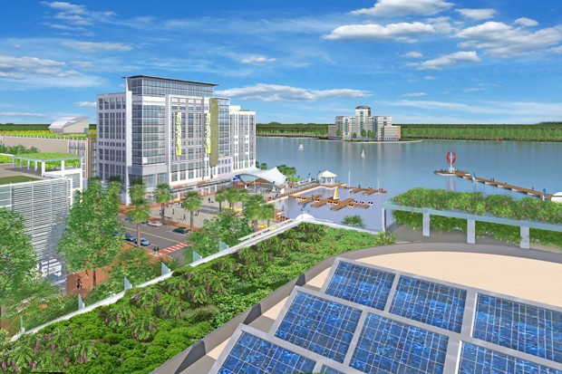
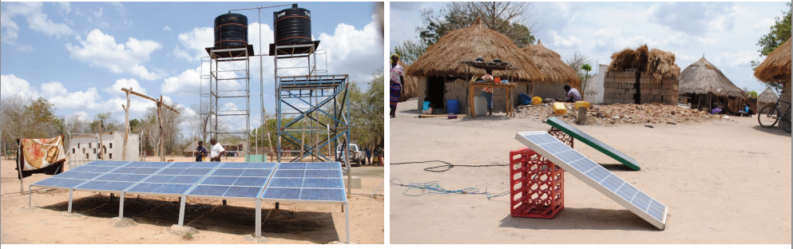
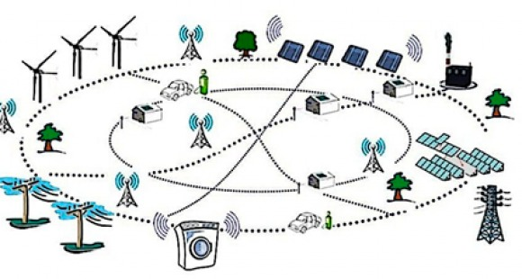
Opportunities
Production
Distribution
Demand

Slide 6
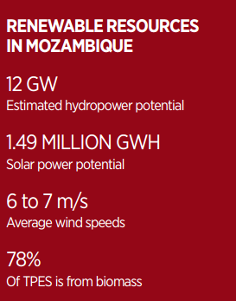
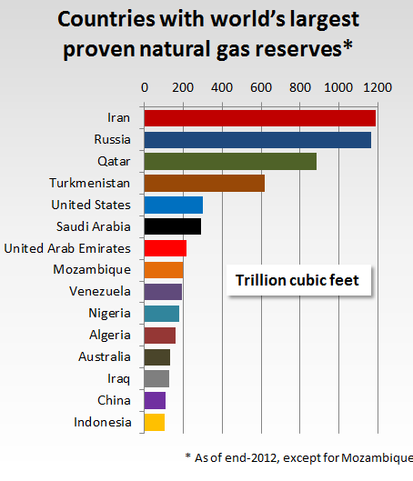
Challenges
Production
v.s

Slide 7
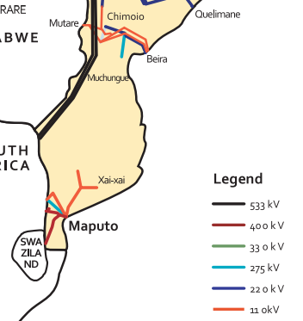
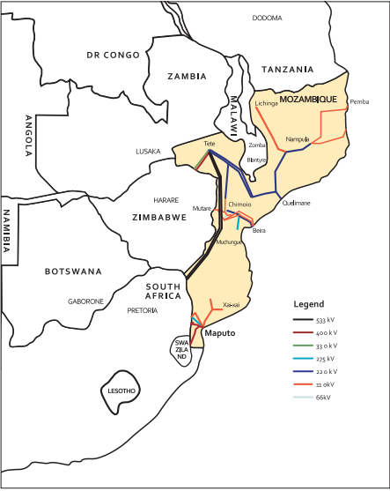
Challenges
Distribution

Slide 8
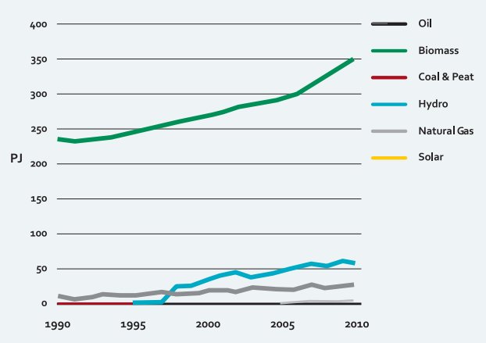
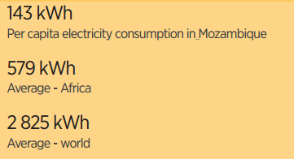
Challenges
Demand

Slide 9
Multi- Sector Challenges
Low – Income
Education
Environment

Slide 10
How to begin?
Training and Education in Renewable Resources;
Sustainable Community Development Projects;
Compiling and sharing of information, in an acessible manner, regarding production, distribution and demand for energy in Mozambique;
  Shared Vision: Sustainable Energy 4 All

Slide 11
Obrigado pela atenção
Associação de Energias Renováveis Moçambique
Av. Avenida 25 de Setembro 1509, 4 andar, Maputo, Moçambique
aermozambique@gmail.com
+258 84 8800761

