Slide 1
The ‘Rising Powers’ and Southern Africa’s Energy Transitions
Marcus Power Durham University
Peter Newell University of Sussex
Royal Society February 3rd 2015
Notes:
Lucy, Wei

Slide 2
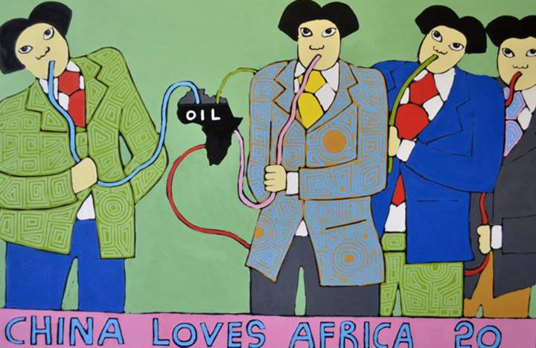
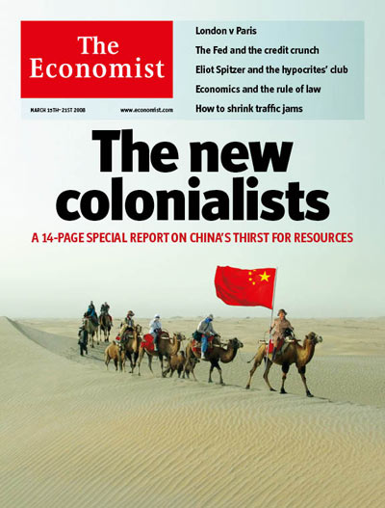
The ‘rising powers’ & ‘South-South’ co-operation
(Re)emergence of BRICs as ‘shapers’ of international ‘development’
Plunder & Grabs: Primarily seen in terms of exploitative acquisition of natural resources (coal, oil & gas)
Points to important and growing role in high carbon economy
Focus is on political economies of resource extraction and geopolitical implications
Energy seen as a natural resource > energy as a set of (socio-technical) systems
Notes:
neo-colonial plunder/grabs
Beyond extractivism-
Capture complexity of engagement with energy systems

Slide 3
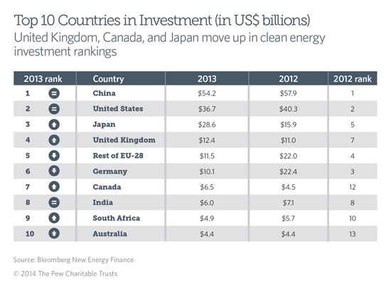
The ‘rising powers’ & energy transitions
This story overlooks simultaneous & growing involvement in clean energy technologies & in reconfiguring energy systems across Africa:
Brazil: global leader in the biofuels industry
China: large hydro projects; world’s largest producer of wind turbines, PV, solar water heaters & small hydro, CCS technologies
India: wind & solar
South Africa: powerful investor within the Southern African region
Notes:
Picture looks different perhaps when we think about energy systems instead of energy as a resource

Slide 4
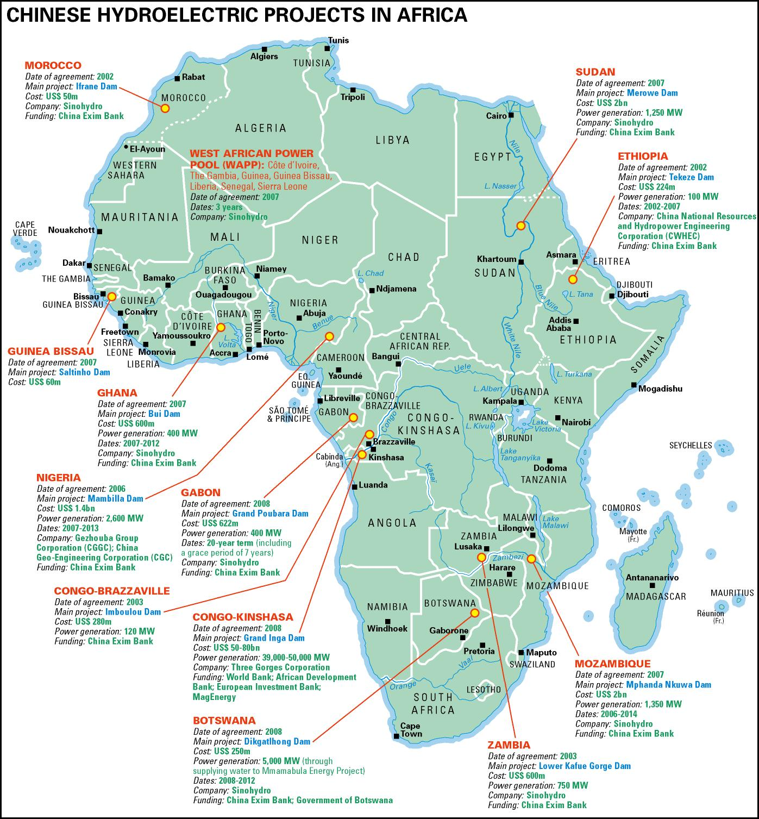
The ‘Rising Powers’ & clean energy
China, India & Brazil increasingly including renewable energy projects as part of their ‘aid’, loan & investment portfolios in Africa
The lure of government subsidies & feed-in tariffs in Africa, the domestic imperative to ‘go out’ in search of foreign markets, renewable energy capacity in return for access to oil, coal, gas etc.
Steady increase in 3 specific capacities:
as exporters of renewable energy equipment (e.g. wind turbines, solar panels, biofuels production technologies)
as investors in local equipment manufacturing (e.g. ethanol or solar water heater manufacturing plants)
as financiers & builders of renewable energy generation (e.g. wind farms, HEP plants)
Notes:
Proyectos hidroelectricos chinos
Interests right across the region- this is just hydro

Slide 5
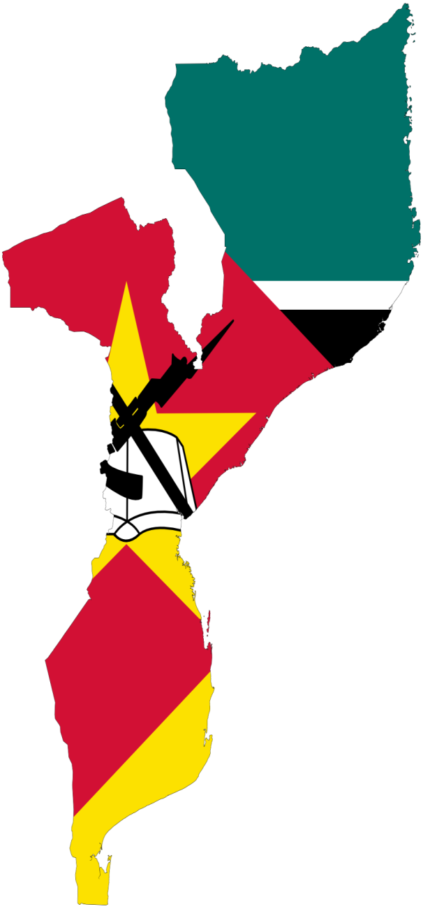
Comparing Energy Systems
Mozambique
Limited grid infrastructure focused on urban spaces & oriented toward export to regional markets
Centralized approach to electricity supply
Low (but rising) levels of access to electricity (21%)
Around 75% of population is off-grid
Approx. 80% of population dependent on biomass
No feed-in tariff or standard agreement for grid-connected RE technologies
Strong dependence on hydro-power
New ‘coal rush’ in Tete, major offshore gas discoveries
Notes:
What are the energy systems in need of transitions & with which they are engaging
Very different energy systems RPs engaging with
Need to understand context in which they’re investing in
Fine and Rustomjee- cheap black labour- virtually free electricity to mining companies
Coming back to Robert’s point- Moz pre-carbon lock-in. Key site in that sense. SA heavily locked in- for set of historical reasons

Slide 6
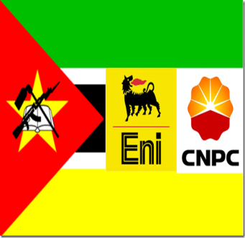
Sustaining a high carbon regime in Mozambique?
New coal resources in Tete attracting mining companies: Vale (Brazil); Tata Steel; Jindal Steel & Power (JSPL); Coal India Ltd
Vale (Brazil) and Jindal (India) have invested in 300MW coal-fired power plants in Tete province
Indian firms (ONGC Videsh) & Chinese firms (China National Petroleum Corporation) have bought stakes in offshore gas
State Grid Corporation of China involved in the construction of new transmission facilities, share in Cahora Bassa
Notes:
Key stakeholders include Vale (Brazil) - has invested US$2 billion and plans for a further US$4 billion in next 5 years
Indian firms a growing presence - Tata Steel, Jindal Steel & Power (JSPL), Bharat Petroleum, Videocon Industries, Coal India Ltd
Vale and JPSL have plans to construct coal-fired power stations
Indian firms (ONGC Videsh, OVL & its partner Oil India, OIL) and Chinese firms (China National Petroleum Corporation) have bought stakes in offshore gas

Slide 7
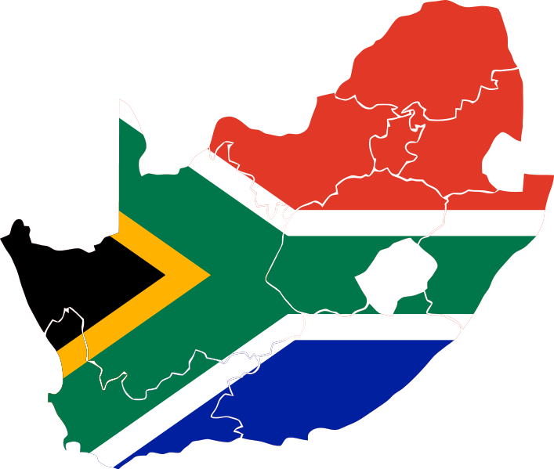
Comparing Energy Systems
South Africa
Fossil fuel dominance
coal-fired electricity (96%)
Electricity intensive industry consume 46% electricity
Incumbent power
Minerals Energy Complex
Energy Inequities:
Grid failure & limited access highly political issues
Kerosene and other fuels dominant for poor households
Notes:
What are the energy systems in need of transitions & with which they are engaging
Very different energy systems RPs engaging with
Need to understand context in which they’re investing in
Fine and Rustomjee- cheap black labour- virtually free electricity to mining companies
Coming back to Robert’s point- Moz pre-carbon lock-in. Key site in that sense. SA heavily locked in- for set of historical reasons

Slide 8
A shifting energy regime in South Africa?
Integrated Resource Plan for electricity (2011): renewable energy will provide 20% of energy mix but continued heavy reliance on coal
Feed-in-tariff and then RE-IPPPP
Finance & technical assistance from European bilateral donors, (Denmark & Germany) DBSA; GEF, UNDP, World Bank & African Development Bank
Rising power engagement
India’s Tata Power & Suzlon are key actors in SA’s wind industry
Chinese companies entered the country’s solar PV sector (Yingli Green Energy, Longyuan Power Group Corporation & Suntech)
Notes:
Shifts in energy systems involving RPs in direct and indirect ways rather than wholescale LCE transition

Slide 9
Multiple Pathways
Multiple & overlapping energy pathways unfolding in both countries
multi-national resource conglomerates playing a key role in coal and oil extraction– embedding high carbon pathways
Development Banks, foreign donors, climate finance, European and RP firms and investment banks emerging as key investors and developers of large scale renewables (e.g. wind, hydro, CSP)
Development finance, NGOs, climate finance supporting emergence of ‘niche’ technologies for local/small scale renewables at household level
These multiple pathways in turn shaped by regional political economies
No one regime/system in transition
Multiple and fragmented regimes across which different forms of energy transition are unfolding
Notes:
These multiple pathways in turn shaped by regional political economies – such as?

Slide 10
Shaped by distinct political economies
Each has different degrees of policy autonomy & developmental space to set the terms of their transitions & to shape the nature of their energy systems
Distinct histories (MEC in RSA/Mozambique’s colonial export economy)
Levels of aid dependence
Variety of capitalism (relations with labour & foreign capital)
Uneven capacity to act as developmental state
Capacity to negotiate terms with global institutions
Notes:
‘Transnational governmentality’ (e.g. global actors such as WTO/IMF), intervention from external agencies in state spaces (including from the ‘rising powers’)
The Minerals Energy Complex (MEC) linking South Africa’s minerals & energy sectors: a regime of accumulation based on low cost state-owned electricity production (via Eskom) & cheap labour
The colonial export economies of Mozambique, the post-war & post-socialist contexts of liberalisation, aid dependency & the spectre of corruption/clientelism/nepotism

Slide 11
 | Potential | Limits
Political Economy | To correct the a-political and a-material basis of some transitions theorizing Identifies the broader ‘push’ and ‘pull’ factors that shape investment in energy systems The (in)capacities of different ‘development states’ to steer that process | Misses the granularity of the practices and consequences of investment decisions and initiatives as they are played out ‘on the ground’ at the micro-scale in the ‘everyday’ contexts of decision-making.
 | Potential | Limits
Transitions | Offer more grounded and context specific understandings of the possibility of social and technological change than broader political economy accounts | On its own it fails to adequately attend to questions of power, statehood, geopolitics and spatiality
 | Capture the assemblages of practices, technologies and actors - differentiation within types of state and fractions of capital | Typically focused on Europe & North America access to energy is more or less universal where structures of energy provision are heavily regulated
 | It matters what kinds of energy transition are taking place – (solar electricity vs. new cook-stoves) - because of who benefits, environmental impacts etc. The technologies are not incidental, but actual serve to create new kinds of networks/coalitions & political economies | Assumptions about nature of state capacity markets institutions & infrastructures that do not hold in the context of Southern Africa
Notes:
Suggests the need to bring PE and transitions in to conversation with one another
Here is our initial take on the potential and limitations of specific literatures- how build on respective strengths & compensate for one anothers’ limits
State capacity is often lacking (to protect niches or manage transitions)
Institutions lack resources (particularly for R&D)
Markets & infrastructural systems are under-developed

Slide 12
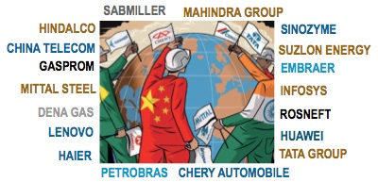
Key findings
The presence of RP actors in Southern African low carbon energy sectors is highly variable
‘Rising Power’ companies are bound up in wider networks
(of construction firms, renewable energy development companies, technology providers & national & international investment coalitions)
Complex, transient & opaque nature of global trade & production networks & transnational flows of investment & finance
‘Rising Powers’ actors are not the determining or dominant actor in any low carbon development sector in either country
Attributing involvement or project ownership in RE to any one ‘rising power’ can be problematic

Slide 13
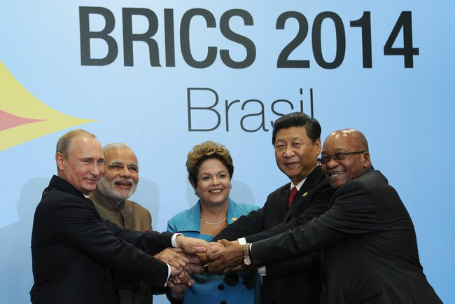
Key findings
RE investment often not a major part of bilateral cooperation, wide variety of state, non-state & quasi-state actors involved
There is no singular/coherent state-led push for overseas RE investment
Low carbon development encompasses a complexity of stakeholders from the public, private, national / international & political & economic spheres
RE investments from ‘rising power’ economies are not predominantly driven by state-led ‘South-South co-operation’ agendas

Slide 14
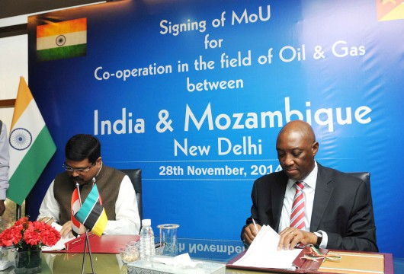
Key findings
Different firms & sections of the state engaging with different actors in each country
Pursuing a myriad of different energy developments
Other emerging economies key (e.g. South Korea, Malaysia, Thailand)
The continuing importance of established actors (e.g. European bilateral donors & RE technology companies)
Disaggregating ‘rising powers’ as an analytical category

Slide 15
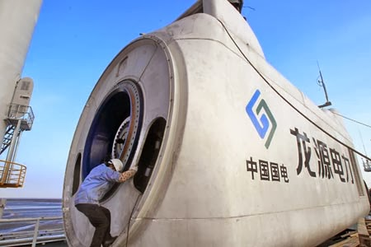
Key findings
Chinese & Indian companies involved in some of SA’s largest wind farms
In SA Chinese firms as suppliers of technological components for PV (e.g. Suntech, Jinko Solar, Yingli Green Energy);
or as manufacturers of technological components under licence to a company from another country (e.g. Vestas turbines/China)
Chinese & Indian firms involved in JVs with South African companies
(e.g. Longyuan Power/Mulilo energy or Exxaro/Tata Power); as the Engineering Procurement & Construction (EPC) company, or as subcontractors (e.g. Powerway)
Critical to follow global supply chains in RE technologies
& the project finance/project development streams

Slide 16
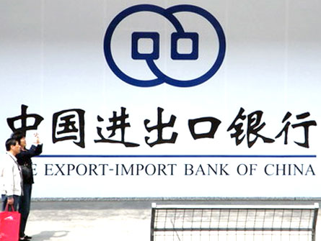
Key findings
Excess domestic capacity (e.g. with solar)
Domination of domestic markets by SOEs
The opportunity to transform from equipment producers to project owners/operators (Goldwind, Sinovel, Jinko, Yingli & CHINT) in overseas markets
Finance, support & market/political analysis available from quasi-state agencies like CDB, Exim & Sinosure
The ‘pull’ of a favourable policy environment (e.g. RE-IPPPP in SA)
Multiple drivers of RE investment from ‘rising powers’

Slide 17
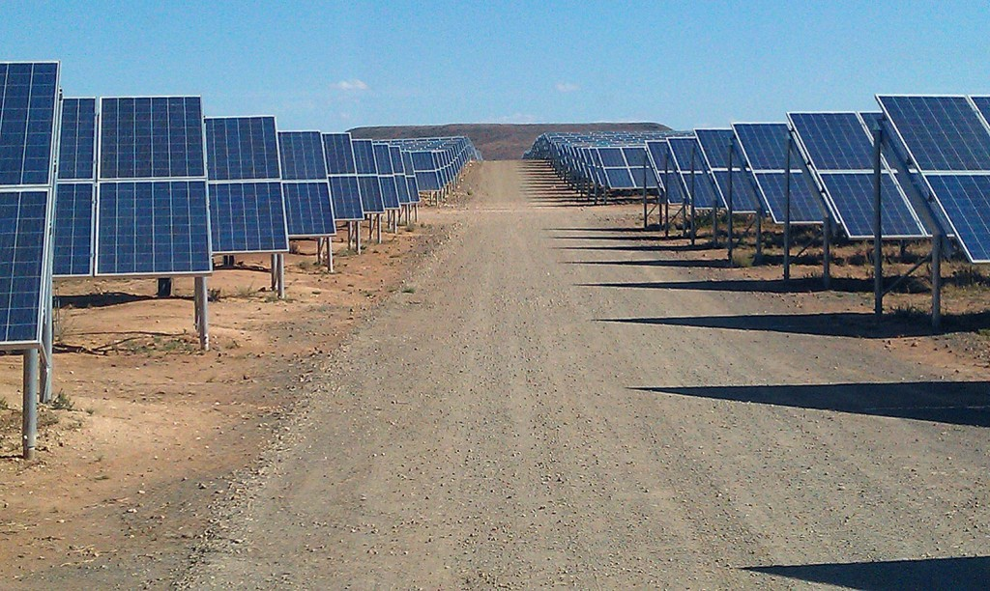
Key findings
Divergent perceptions of the benefits of RP technology/practices
Increased use of solar PV and hydro-power in Mozambique & of solar & wind energy in South Africa
RE ‘progress’ has been inconsistent & socially/spatially variable
A fossil fuel based ‘business as usual’ trajectory?
Multiple & fragmented regimes across which different forms of energy transition are unfolding
Embryonic attempts in SA and Mozambique to diversify the energy mix
Increased RP interest in investing in renewable technologies & infrastructures

Slide 18
Further Information
http://www.dogweb.dur.ac.uk/the-rising-powers/

